Slide 1

#Self-Esteem Part 3
Michael Noll Counseling, LLC
Healthy Interactions Group (HIG)

Slide 2

Where We Going Today??
La st Time
How to Build Self-Esteem
  Unconditional Human Worth
  Unconditional Love
  Growing
This Time
Positive Side of Neutral
Cognitive Distortions (a.k.a. Thinking Errors or Stinkin’ Thinkin’)

Slide 3


So…I Know It All Now, Right?!
The Positive Side of Neutral
Fear of Judgement
-Recognize
Irrationality
Treatment
of Self
-Give me a break
-I’m human
Perception
of the World
-Positive Side of Neutral
View of the Past
-Internal
-External
Success/Failure
-See Successes
-Accept
-Feel Judged
-Feel Rejected
-Hard on Myself
-Should be Perfect
-Negative Perspective and Focus
-Regret Choices
-Angry about things done to me
-Feel Like a Failure
-Not Special
This Photo by Unknown Author is licensed under CC BY-NC

Slide 4
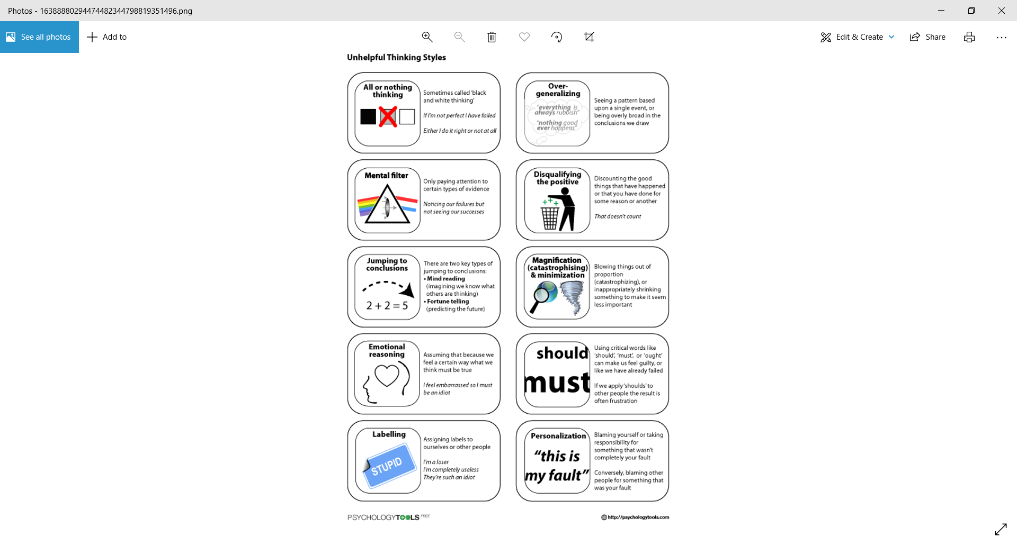
Anything Else?
Dumb question, right?! Of course there’s more!
Cognitive Distortions, (a.k.a. Thinking Errors or Stinkin’ Thinkin’
  Unhelpful Thinking Styles
  Ways our thoughts are biased
  Ways we “make sense” of the world around us
  Short Cuts
All or Nothing, Black and White, or Polarized Thinking:
“I missed one day. Might as well give up.”One thing happened. The brain turned it into everything.

Slide 5
More? Yes, Please.
Overgeneralizing:
Tasha shares an idea in a group, and nobody responds. “Nobody cares what I have to say.”
Mental Filter:
Taylor gets several positive comments on a presentation. One person points out something they could have done better.Taylor goes home thinking, “I screwed that up.”
Disqualifying the Positive:
Alex gets several compliments on a new haircut.“They're just being nice. It doesn't really look that good.”

Slide 6
Even More? F’Real?
Jumping to Conclusions:
Jordan sends a text and doesn't get a response for a few hours.“I must have pissed them off.”
Magnification and Minimization:
Taylor gets 9 things right and makes 1 mistake.“I can't believe I screwed that up.”“The other 9 weren't that big a deal.”
Emotional Reasoning:
Alex feels like a failure after making a mistake.“I feel like a failure, so I must be one.”

Slide 7
Seriously?
Should Statements:
Morgan's friend cancels plans at the last minute.“They should have given me more notice.”
Labeling and Mislabeling:
Jamie forgets an appointment. → “I'm such an idiot.”
Personalization:
Riley's teenager gets a bad grade on a test.“I must be a terrible parent.”

Slide 8
Done? Already?!
Recap
More Self-Esteem
  Positive Side of Neutral
  Cognitive Distortions (a.k.a. Thinking Errors or Stinkin’ Thinkin’)
Next Time
CoDependency
  Not necessarily what you think it may be

