Slide 1

#ThoughtMapz
Week 2
Michael Noll Counseling, LLC
Healthy Interactions Group (HIG)

Slide 2

Where We Going Today??
Recap Last week:
  Thought Mapz:
    Over time, millions of thought maps are formed in response to events experienced. These include how we behave, feel and think. While the original thought map (TM₀) never goes away, it is no longer the default response.
    This model gives insight into what steps need to be taken to achieve positive, lasting change. It should be noted, however, that change is not easy and it needs to be nurtured to help the individual not fall back into the old or recycled way of thinking.
Thought Mapz Continued
  Negative Thinking
  Rational Thoughts

Slide 3
What’s this Cognitive Behavioral Schtuff?!
Cognitive:
  1: of, relating to, being, or involving conscious intellectual activity (such as thinking, reasoning, or remembering) cognitive impairment
  2: based on or capable of being reduced to empirical factual knowledge
Behavioral:
  1: of or relating to behavior : pertaining to reactions made in response to social stimuli
  2: relating to or concerned with the social, psychological, and emotional factors that affect financial decisions and behavior
Cognitive Behavioral Therapy:
  : psychotherapy that combines ”cognitive therapy” with ”behavior therapy” by identifying faulty or maladaptive patterns of thinking, emotional response, or behavior and substituting them with desirable patterns of thinking, emotional response, or behavior —abbreviation CBT
  NOTE: Cognitive behavioral therapy is used in the treatment of various mental and emotional disorders including depression, anxiety, anorexia, and substance abuse. Cognitive therapy and cognitive behavioral therapy are often used interchangeably.

Slide 4
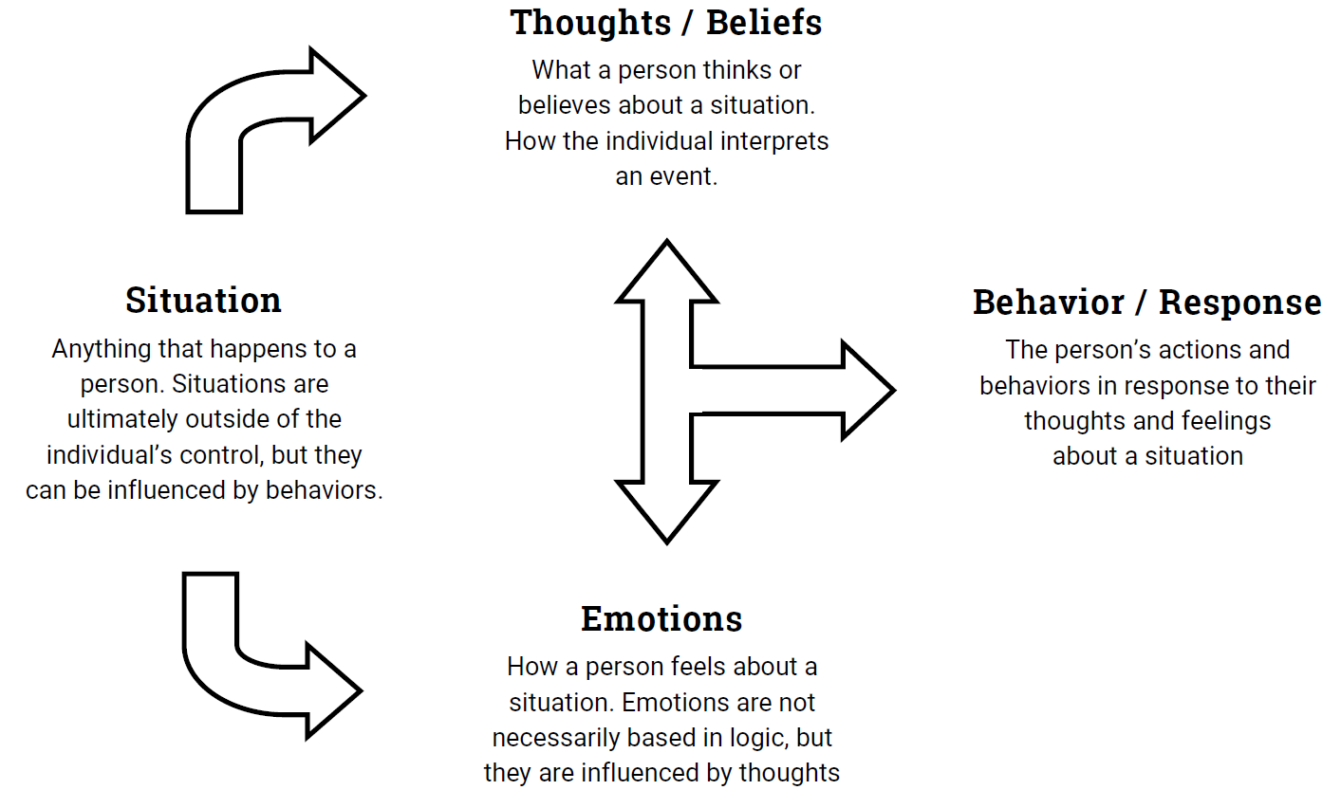
Ok, So What?!

Slide 5
Examples? Please and Thank You!
2 Ways Different People Experience the Same Situation:
Situation: Jason and Kurt receive negative eval’s at work
Jason
Negative Thought: “I can’t do anything right. I bet I get fired because of this!”
Emotion: Depressed and nervous.
Behavior: Jason avoids his boss because he believes he’s in trouble. He feels nervous the next time he’s confronted with challenging work,
and performs poorly.
Kurt
Rational Thought: “I guess I didn’t work hard enough—I’ll have to come up with a better plan for next time.”
Emotion: Disappointed but motivated.
Behavior: Kurt seeks out his boss to talk about how he can improve. He approaches his next task as a
challenge and gradually improves.

Slide 6
Okey? Your Turn! ;)
Situation: You are invited to a party by an acquaintance.
You:
Negative Thought: “I won’t know anyone at this party and I’ll just seem out of place. They probably invited me because they felt obligated”
Emotion: Sad and anxious.
Behavior: You lie and tell them you already have plans for the night of their party. You fail to develop their friendship
You:
Rational Thought:
Emotion:
Behavior:

Slide 7
Challenge Time!
Answer the following questions to assess your thought
  What is the (Is there) evidence for my thought(s)?
  Is there any evidence contrary to my thought?(s)
  Am I attempting to see this situation without all the evidence?
  If I look at this positively, how will it change?
  Will this matter a year from now? Five years?
  What would I say to a friend? An acquaintance?

Slide 8
Summary and Next?
Summary:
  Event ➡️ Thoughts ➡️ Behaviors
  Event ➡️ Thoughts ➡️ Feelings
  Feelings 🚫 ➡️ Behaviors
Counter Your Negative Thoughts With Rational Ones
  Use the Questions to make the most informed choice for you
    What is the (Is there) evidence for my thought(s)?
    Is there any evidence contrary to my thought?(s)
    Am I attempting to see this situation without all the evidence?
    If I look at this positively, how will it change?
    Will this matter a year from now? Five years?
    What would I say to a friend? An acquaintance?
Next
  Grief & Loss

