Slide 1

Are You #Stressed?
Michael Noll Counseling, LLC
Healthy Interactions Group (HIG)

Slide 2

Where To…??
Last Time:
  Guilt vs Shame
    Emotion vs Feeling
    Same? Different?
    Who knows, Who Cares, Why Bother?
This Time:
  Stress, Anxiety and Whatever Else
  Stress Curve
  Cold Hands, Fast Heart

Slide 3

Whadya say?
Stress, or as it may be referred to “anxiety,” is a normal response to changes that we experience through everyday activities
  Usually used to describe negative situations, which has led us to believe that stress is something to avoid
  Excessive amount of stress can be harmful to physical and mental abilities
  Not always a negative reaction to life
2 Types (or flavors )
  Distress is what we usually think of; Negative
  Eustress (pronounced YOU-stress) is a positive type of stress. I like to think of eustress as being in the “zone”
    The zone is a place where things flow well psychologically, physically and biologically

Slide 4
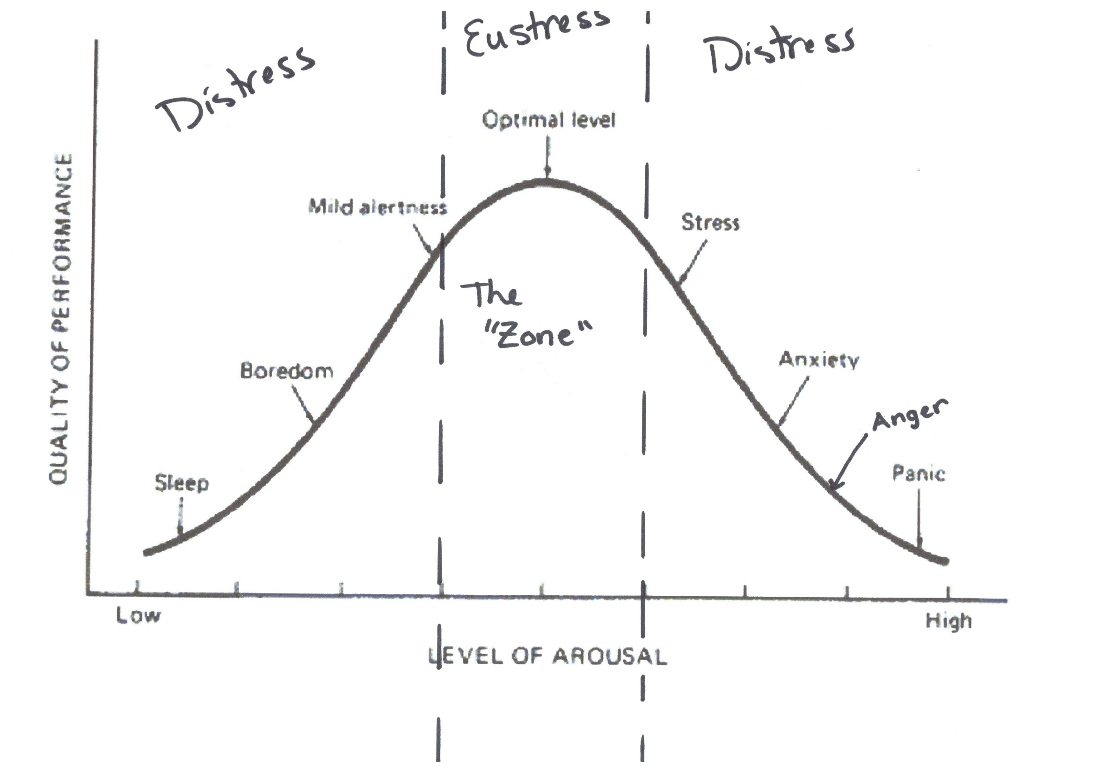
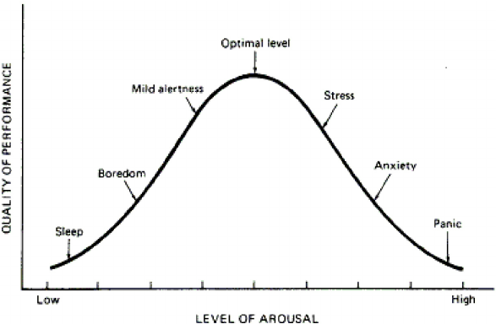
The Curve

Slide 5
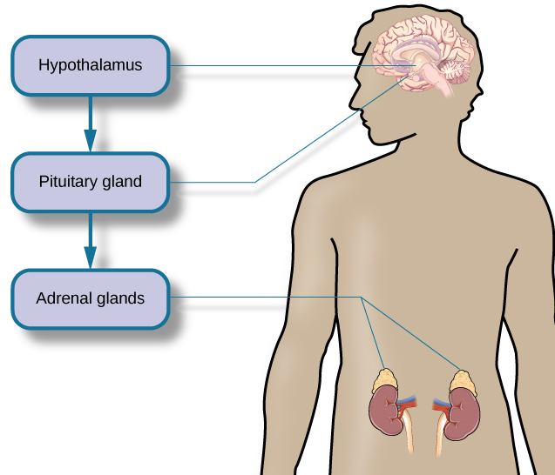
Cold Hands, Fast Heart
The human body instinctively reacts to stress by releasing hormones that control the heart rate and breathing. We’re talking fight or flight—the innate human response to stress.
3 Key Parts of the body control the hormones: In the brain: hypothalamus (high-po-THAL-uh-mus) and pituitary (pih-TOO-ih-tair-ee) glands
Top of Kidney’s: adrenal (uh-DREE-nal) glands
The hypothalamus signals the pituitary gland that signals the adrenal glands to release the stress hormones epinephrine (ep-i-NEF-rin), norepinephrine (nor-EP-i-NEF-rin), and cortisol (KORT-ti-zol) (increase heart rate and breathing), which provide a burst of energy (to fight or flight), as well as affect other bodily functions.

Slide 6
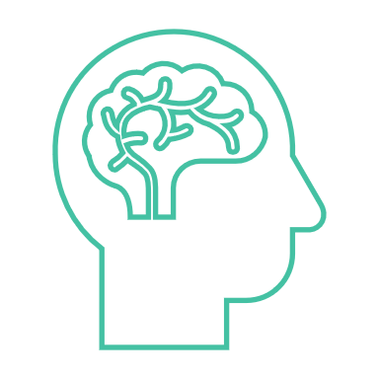
Who Cares About the Brain?
The Chemicals released may cause a variety of issues (stress/anxiety)
Headaches – not enough blood flowing to the brain (don’t need it when running from a bear)
Hard to Concentrate – short term memory is basically shut-off, cuz you don’t need it, you just need to be able to fight or flee
Dry Mouth/Hard to Swallow – (see headaches); only necessary functions to keep you alive are working in major stress times
Heart Pounding – these hormones speed up the heart rate – again, keep you alive
Nausea/Hangry – hormones do a number on your digestive track (same thing, but seem different)
Hard to Sleep – energy (adrenaline) is keeping you “awake” – needs to be shut down

Slide 7

Questions?

Slide 8
We’re Done Already?
Stress Management
  Stress, Anxiety and Whatever Else
  Stress Curve
  Cold Hands, Fast Heart
    Hormones and something else
What’s Next?!
  Stress Management – Let’s Manage It Better!
  Compliance Letters Due by Next Thursday!

