Slide 1

#Self-Esteem Part 2
Michael Noll Counseling, LLC
Healthy Interactions Group (HIG)

Slide 2

Where We Going Today??
Last Time
  Self Esteem
    Review of Concepts
This Time
  How to Build: Self-Esteem
    Human Worth (Unconditional)
    Unconditional Love
    Growing

Slide 3
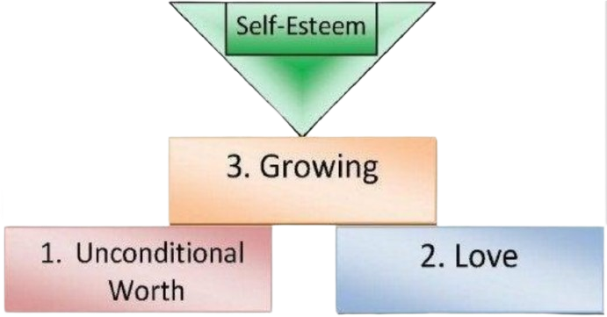
So…How Do I Build This Schtuff?!
Note: All three factors are essential in building self-esteem, but the sequence is crucial.
Self-esteem is based first on unconditional worth,
then love
and finally growing.

Slide 4
Unconditional Human Worth
Unconditional
  Without conditions or limits
Worth
  Monetary value ($$$)
  Measured by quality or value
Human Worth
  You are important and valuable as a person
  Your essential, core self, is unique, precious, of infinite – eternal - unchanging value, and good (at the core)
  Unconditional human worth implies that you are as precious as any other person
    no one is better or worse than anyone, no matter what they have done (or haven’t) in life – Read that Again!

Slide 5
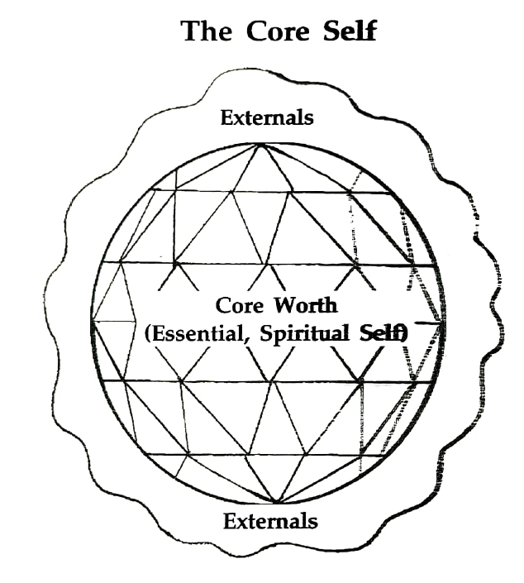
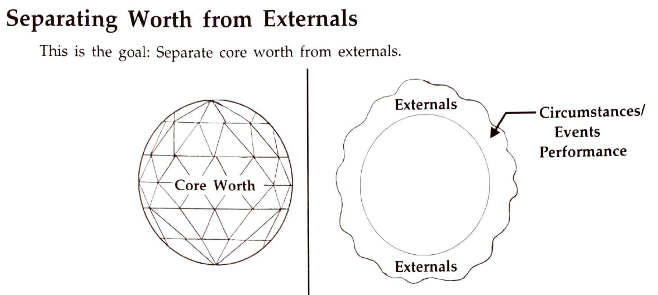
Unconditional Human Worth
Separating Worth from Externals
It’s difficult to have a positive view of yourself with TV/Social Media, etc, that tells you – “you’re not worth much unless you’re beautiful, young and wealthy”

Slide 6
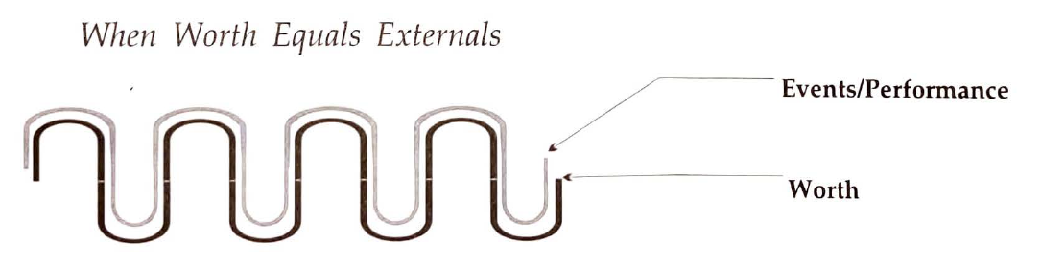
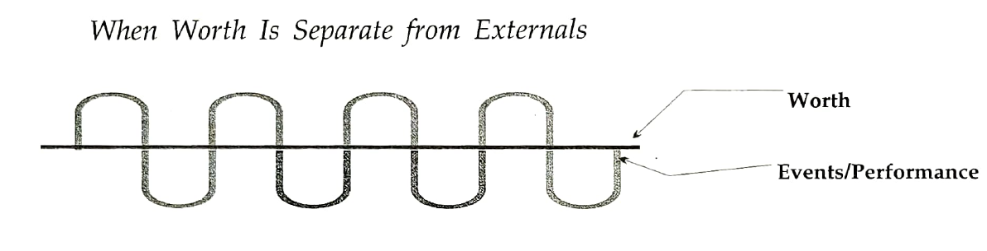
Unconditional Human Worth
2 Ways to look at this:
  Worth equals externals
  Worth is separate from externals

Slide 7

Unconditional Love
Love is a wholesome feeling, an attitude of wanting what’s best for you – and making the choice daily
Psychological health and growth depend on love
Love is learned, acquired and cultivated with daily practice
After cultivating love of self, it is always there – dependable, even if there is no love from others

Slide 8


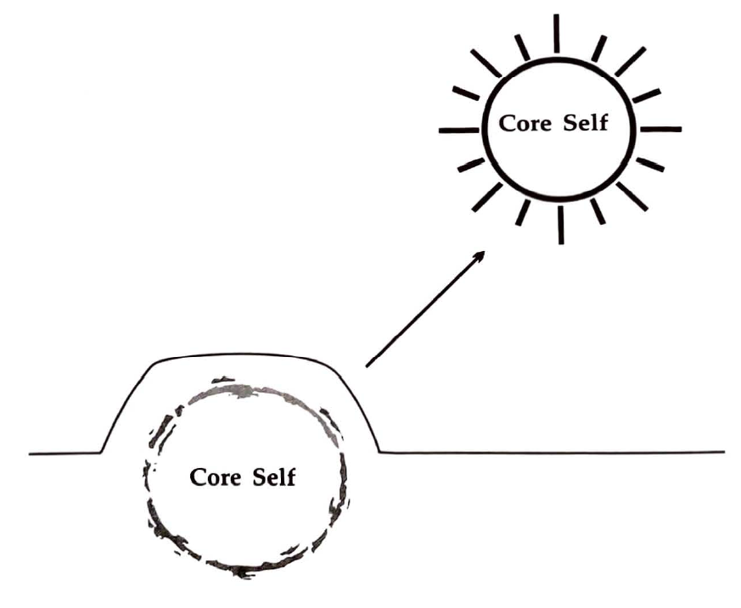
Growing
A calm feeling of being even more of what you are at the core
Time where we are developing the
traits we are born with
The Short Answer:
  Time we are developing our capabilities
  and potentials
  Ascending, moving toward excellence
  Elevating humanity, both others and self

Slide 9

Questions
Does it all make sense?
What are you left wondering?
How do you feel your Self-Esteem is today?
(compared with your understanding from before we started talking through it all)

Slide 10
Done? Already?!
Recap
How to Build Self-Esteem
  Human Worth
  Unconditional Love
  Growing
Next Time
More Self-Esteem
  Positive Side of Neutral
  Cognitive Distortions (a.k.a. Thinking Errors or Stinkin’ Thinkin’)

