Slide 1
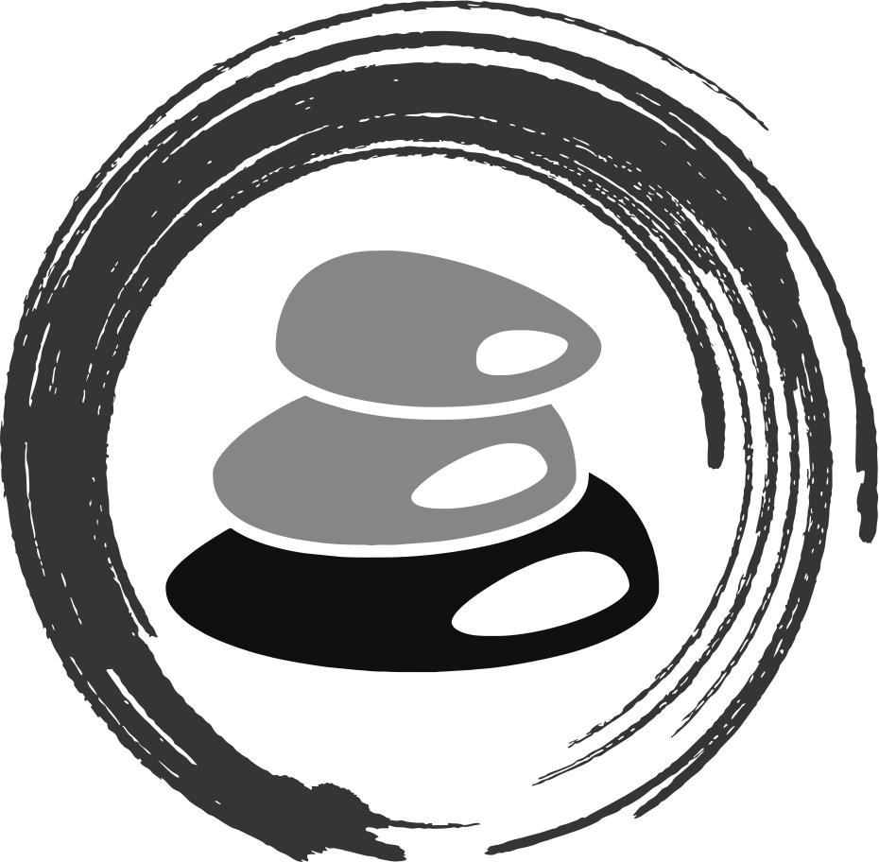
#Self-Esteem
Michael Noll Counseling, LLC
Healthy Interactions Group (HIG)

Slide 2
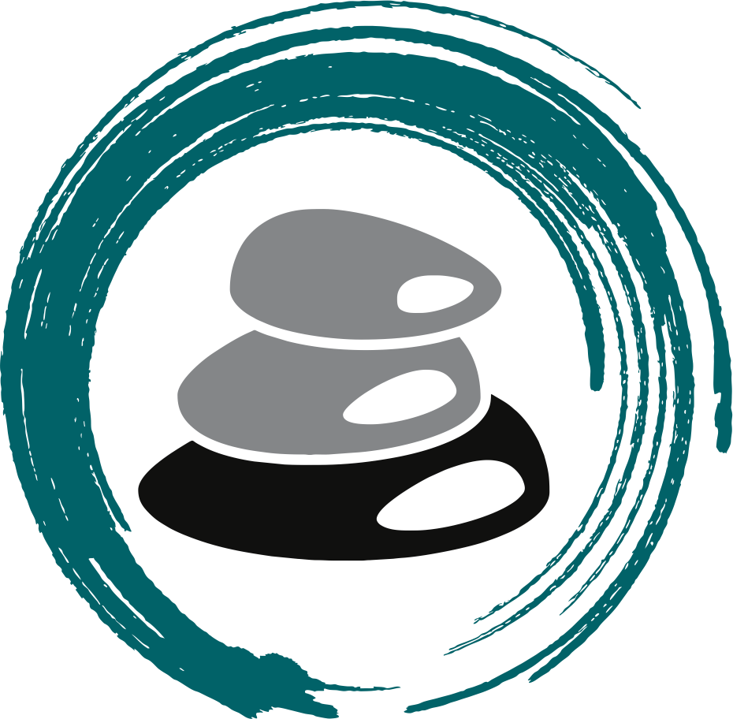
Where To??
A Week Ago…
  Styles of Communication
    4 of Them
    What They Actually Mean
    “I” Statements
Now…
  An Assessement
  What’s Self-Esteem?
  Concepts
  Cost/Benefit Analysis
  Foundations of Self-Esteem

Slide 3
Knowledge Check?
Rate Yourself from 0-10 (0=Nope 10=Absolutely)
The Self-Esteem Checkup
_____ I am a worthwhile person
_____ I am as valuable as a person as anyone else
_____ I have the qualities I need to live well
_____ When I look into my eyes in the mirror, I have a pleasant feeling
_____ I don’t feel like an overall failure
_____ I can laugh at myself
_____ I am happy to be me
_____ I like myself, even when others reject me
_____ I love and support myself, regardless of what happens
_____ I am generally satisfied with the way I am developing as a person
_____ I respect myself
_____ I’d rather be me than someone else

Slide 4
Knowledge Check?
Next, rate your self-esteem on the following scales (Guahtier, Pellerin, and Renaud 1983):
0 100
|----------------------------------------------------------------------------------------------------------------------------------------|
Total lack of Total fullness of
Self-esteem Self-esteem
Your Response ______
How often do you feel restricted in your daily activities because of difficulties with self-esteem?
1 2 3 4 5
|--------------------------------|---------------------------------|--------------------------------|--------------------------------|
Always Often Sometimes Rarely Never
Your Response ______
How serious is your problem with self-esteem?
1 2 3 4 5 6
|--------------------------|--------------------------|--------------------------|--------------------------|--------------------------|
None Mild Moderate Severe Extremely Incapacitating
Your Response ______

Slide 5
What’s That??
Self-Esteem is a realistic, appreciative, opinion of oneself
  Realistic means accurate and honest
  Appreciative implies positive feelings and liking
Usually measured as high or low, which makes it seem like a numbers game - competitive or comparative. It works better when we say that those who possess self-esteem have a realistic and appreciative opinion of themselves. Or better yet, healthy vs. unhealthy
  The figure below clarifies the meaning of self-esteem. It’s a balance between self-defeating shame and self-defeating pride.
  Shame: below others, unworthy, beneath them
  Pride: Arrogant/Narcissistic
Self-Defeating Shame Self-Esteem Self-Defeating Pride

Slide 6
How Do I Get There?
What Leads to Self-Esteem?
Research is pretty clear:
  “Choose your parents well”
  Quick Story (hit’s me in the feel’s everytime!):
  A man asked his neighbor, "Why did you spend all day with your son fixing that bike, when the bike shop could have fixed it in an hour?" The neighbor replied, "Because I am building a son, not fixing a bike.“
  Parents/Mentors help in building, especially as they show/build the kiddo up
    "I trust you, but I also recognize that you are not perfect. Still, I love you, and therefore will take time to guide you, set limits, discipline you, and expect the best of you because I believe in you and value you.“
  But, what if there are no parents involved, how does one have self esteem?

Slide 7
What’s Involved?
Identity
Identity provides a sense of oneself and one’s individuality
It answers these questions: “Who am I?” and “What defines me and my essential character?”
Appreciate
To think well of, value, to enjoy
To recognize gratefully
To rightly estimate the quality or worth of someone or something
Accept
To receive favorably and with pleasure, to approve, to believe in, and to respond favorably to someone or something
  Self-acceptance is to believe in oneself favorably and with pleasure
So we may accurately acknowledge weaknesses, be determined to improve, and still accept oneself

Slide 8
There’s Gotta Be More…
Self-Confidence
The belief in one’s own abilities
Related to competency and self-efficacy
As one’s competence increases, one’s confidence does too
In a broader sense, self-confidence is a belief in oneself as a person
  The general sense of, “I can do it!”
Pride
2 sides: self-defeating and healthy
  “Self-defeating pride” is the attitude that one is superior, more valuable, or more important as a person than others.
    Perceive themselves as more capable, self-sufficient, or infallible than they actually are
  “Healthy pride” is a realistic sense of one’s own dignity or worth; self-respect; and gratitude and delight in one’s achievements, talents, services, or membership (that is, in family, race, and so forth)

Slide 9
More?…Usually!
Humility
2 sides: self-defeating and healthy
  “Self-defeating humility” is spineless submissiveness, contemptibly, and an abject lack of self-respect
  “Healthy humility”, on the other hand, involves the absence of self-defeating pride, and the recognition of one’s imperfections or weaknesses, a consciousness of one’s own shortcomings and ignorance, and teachableness. Healthy humility relates to meek behavior in the positive sense, meaning one is mild, patient, and not easily stirred to anger
A person with self-esteem possess both healthy humility and healthy pride:
  Humility because they realize how much they have left to learn, and pride in recognizing the dignity and worth one shares with all other humans

Slide 10
Even More?…Duh!
Selfishness
Some mistakenly equate selfishness with self-esteem
So let’s make an important differentiation:
  The purpose of self-esteem is to transcend the self
  Self-consciousness is a painful situation that keeps one’s focus inward
  Healing the pain with love, enables one’s focus to expand outward, making one freer to love others and enjoy life
  The person with self-esteem loves by choice from a secure base (as opposed, say, to a codependent individual who possesses neither self-esteem nor choice)
Thus, building self-esteem warrants our best efforts

Slide 11
What’s the Cost?
Cost-Benefit Analysis
Some do not build self-esteem because they don’t know how -- others resist because there are apparent advantages to self-dislike. Before investing the time in building self-esteem, let’s do what an effective manager would do before considering a new plan: a cost-benefit analysis.
  First, list all the advantages of self-dislike you can think of
  When you are finished, list all of the disadvantages
  Next, the disadvantages of Emotional Change
  Finally, list the advantages of Emotional Change

Slide 12
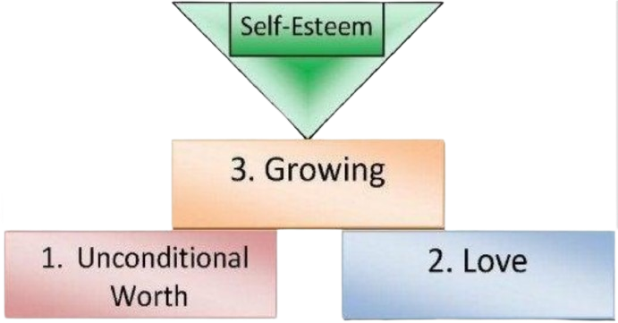
Let’s Build?!

Slide 13
Can We Stop Now?
Recap
  Assessment
  What’s Self-Esteem?
  Some Concepts
  Cost/Benefit Analysis
  Foundations of Self-Esteem
Up Next
  Foundations of Self-Esteem Expanded
    Unconditional Worth
    Love
    Growth

