Slide 1

Healthy
Relationships
Michael Noll Counseling, LLC
Healthy Interactions Group (HIG)

Slide 2

Where We Goin’…??
That time…
  What’s a Relationship
    Quiz
  Relationship Tree
This time…
  It’s ALL about Power
  No, it’s ALL about Control
  Nope!! It’s really about Equality ;)

Slide 3
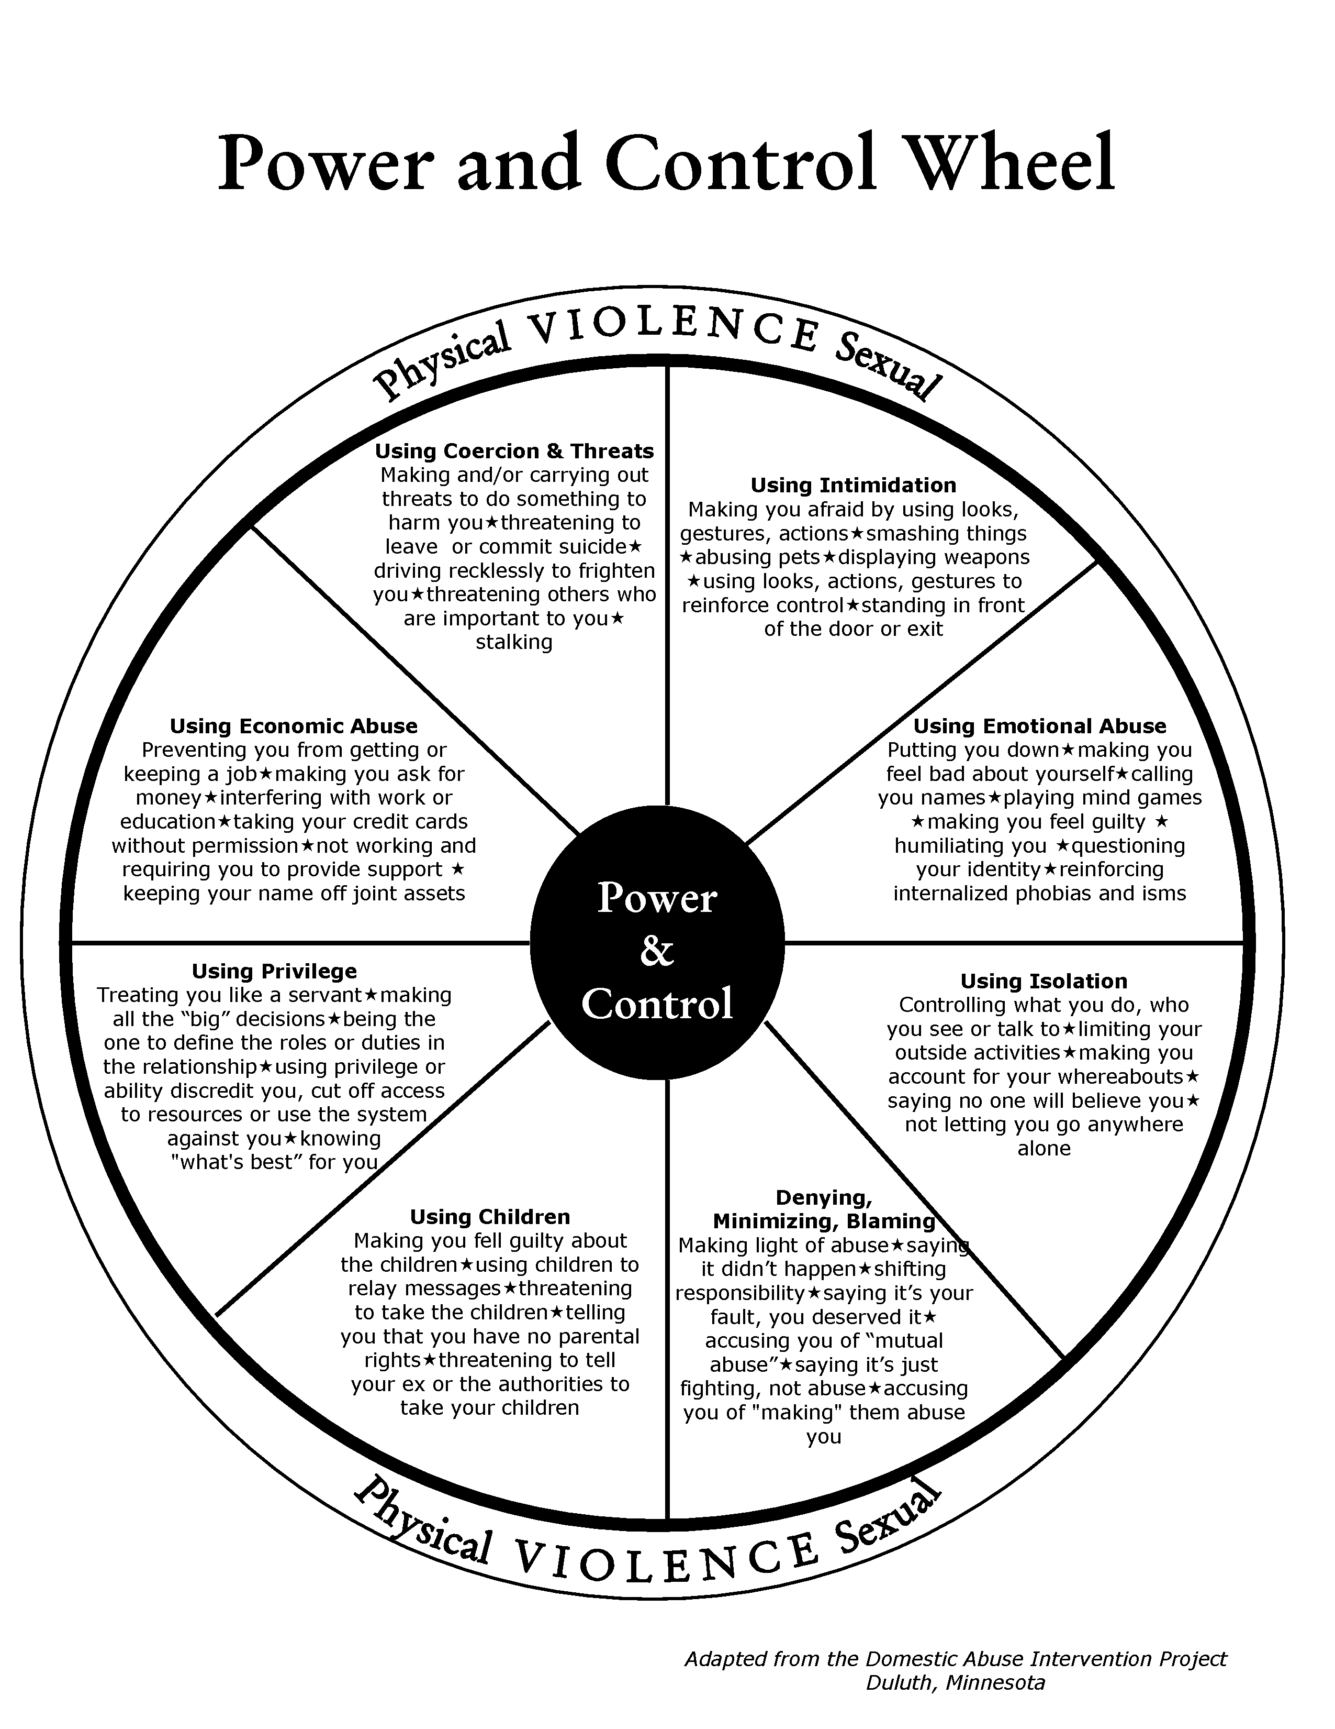
Power/Control
The Duluth Model is the most common batterer intervention program used in the United States. It was developed to reduce male on female violence.
Critics argue that the method can be ineffective as it was developed without minority communities in mind and can fail to address root psychological or emotional causes of abuse, in addition to completely neglecting male victims of abuse
Criticism of the Duluth Model has centered on the program's insistence that men are perpetrators who are violent because they have been socialized in a patriarchy (‘man’s world)’ that condones male violence, and that women are victims who are violent only in self defense.

Slide 4
Power/Control – Problem!
It's a gender-polarizing approach that only serves to perpetrate the "battle of the sexes.“
It's about blaming and shaming men, more than giving them the insights and support to help them stop their abusive behavior.
It ignores drinking, drugs, Borderline Personality Disorder and other serious psychological problems.

Slide 5

Power/Control – Fixed?
There is some truth in this, just not the way the authors originally planned
The updated Power/Control Wheel is
not geared only toward men
Intimidation
  Making him/her afraid
  Smashing things
  Destroying Property
  Harming pets
  Displaying Weapons

Slide 6
Power/Control
Emotional Abuse
  Put Downs
  Name Calling
  Mind Games
  Humiliation
  Making someone feel guilty
Isolation
  Controlling what they do, see, read and where they go
  Limited outside involvement
  Uses Jealousy to justify actions

Slide 7
Power/Control
Using Children
  Feeling guilty about children
  Using them to relay messages
  Using visitation to harass them
  Threatening to take the kids away
Denying, Minimizing, Blaming
  Making light of abuse
  Saying it didn’t happen
  Shifting responsibility
  Saying they caused it

Slide 8
Power/Control
Economic Abuse
  Preventing partner from getting/ keeping a job
  Making them ask for money
  Giving allowance/taking money
  Requiring partner to work, to provide support
Privilege
  Treating partner like a servant
  Making all the big decisions
  “Master of the Castle”
  Defining gender roles
  Culture/Religion

Slide 9
Power/Control
Coercian/Threats
  Making and or carrying threats to harm you/others
  Threatening to leave or commit suicide
    Report to “Welfare”
    Drop charges
    Doing illegal things
  Maintenance Behaviors

Slide 10
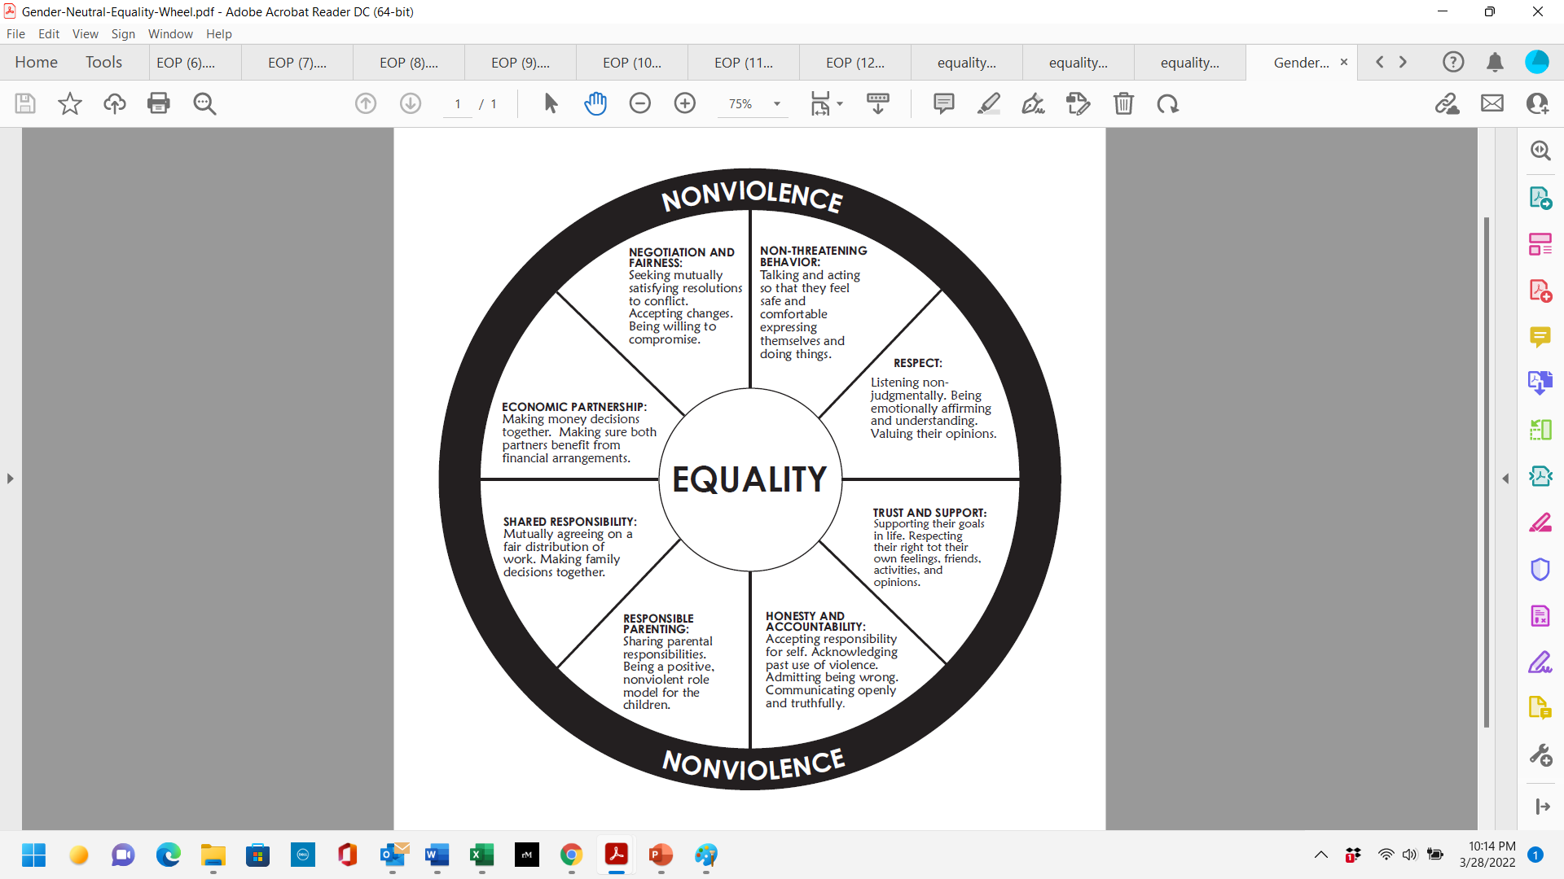
Equality Wheel
The Equality Wheel was created to show
  Non-Violence :
    There is no place for violent acts or behaviors in a healthy relationship
    Examples of violent acts or behaviors include:
yelling
throwing things
hitting
name-calling
unwanted touching
stalking
pushing
minimizing feelings
forced sex

Slide 11
Equality Wheel
The Equality Wheel was created to show
  The Equality Wheel' is a model used to
  explain the dynamics of a healthy relationship: friends, dating partners, intimate/life partners, or family members
  Each component of the wheel supports and reinforces the others; equality always at the center
  Guide to maintaining healthy patterns in a relationship

Slide 12
Equality Wheel
Non-Threatening Behavior
  Talking and acting so that partner feels safe and comfortable expressing themselves and doing things
Respect
  Listening nonjudgmentally
  Being emotionally affirming and understanding
  Valuing opinions

Slide 13
Equality Wheel
Trust/Support
  Supporting goals
  Respecting their right to own feelings, friends, activities and opinions
Honesty/Accountability
  Accepting responsibility for self
  Acknowledging past use of violence
  Admitting being wrong
  Communicating openly and truthfully

Slide 14
Equality Wheel
Responsible Parenting
  Sharing responsibility
  Positive non-violent role model
Shared Responsibility
  Mutually agree on fair distribution of work
  Make family decisions together

Slide 15
Equality Wheel
Economic Partnership
  Making Money decisions together
  Making sure both benefit from financial arrangements
Negotiation and Fairness
  Seeking mutually satisfying resolutions to conflict
  Accepting changes
  Willing to compromise

Slide 16
Done Already?!
Recap
  It’s ALL about Power
  No, it’s ALL about Control
  Nope!! It’s really about Equality ;)
Next Time
  Trust
  Love Languages

