Slide 1

Healthy
Relationships
Michael Noll Counseling, LLC
Healthy Interactions Group (HIG)

Slide 2

Where To…??
That time...
  Anger Triggers
  Anger & Relaxation
This time…
  What’s a relationship got to do with it?
    Quiz
  Relationship Tree

Slide 3
Quiz Time
Directions: Indicate who, in your relationship, does the following:
Neither or
Both
One Person
Considers partners likes/dislikes when making plans
Shares things he/she likes about their partner
Supports partner in setting/meeting personal/professional goals
Encourages partner to be the person they want to be/are
Comforts partner when upset, sad, frustrated, etc
Asks for/listens to partner’s point of view (even when arguing/disagreeing)
Respects partner’s need for alone time
Treats partner’s property/belongings well
Treats partner as equal

Slide 4
Quiz Time
Neither or
Both
One Person
Respects online privacy (FB, Insta, email, text, etc.)
Respects decisions around sex
Ok with partner spending time with friends/family
Trusts that partner is being honest about his/her actions/activites
Cares if the other person has fun when going out
Communicates respectfully both publicly and privately
TOTAL: Count the number of X’s from the BOTH column only

Slide 5
Did You Win?!
Scores of 0-8: Relationship has room for improvement. To be healthy, both people need to contribute equally. Scores in this range indicate that the relationship is either One-Sided or nobody’s trying very hard. It may work with combined effort and commitment, but it’s probably time for a reality check for you both. Ultimately, ask yourself…”Does this relationship feel good to me?”
Scores of 8-12: Relationship has potential, but may take a good amount of work. If you both want to continue in the relationship, you both need to pick areas to work on in order to create a healthier relationship. Make it shared goal with your partner to increase the amount of X’s in the Both column.
Scores of 12-16: You’re on track for a healthy relationship! These take time and effort, you are both working on it. You have high levels of trust, support, fun, equality and respect. Keep up the good work and remember…”there is always room for improvement.”

Slide 6
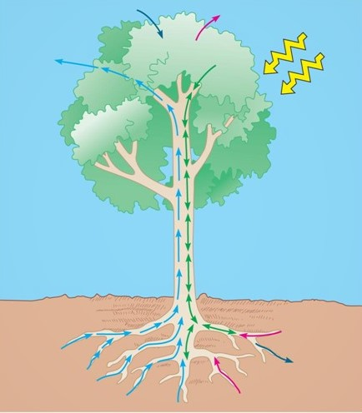
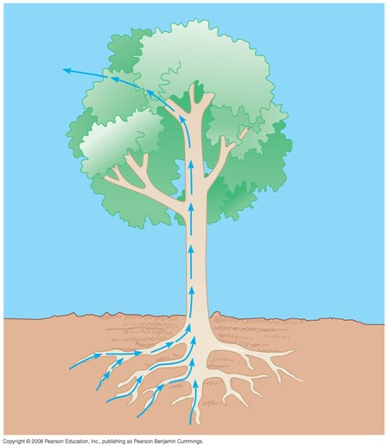
What Can A Tree Tell Us?!
Let’s talk botany
  Trees pull water and minerals in through
  the roots from the soil, which travels up
  the trunk and out to the foliage
  (leaves/fruits) and disperses O² (Oxygen)
  for the world
  Photosynthesis – sun shines down
  signaling the leaves/branches to pull
  CO² (Carbon Dioxide) in, make sugar
  and disperse new minerals into the
  soil

Slide 7
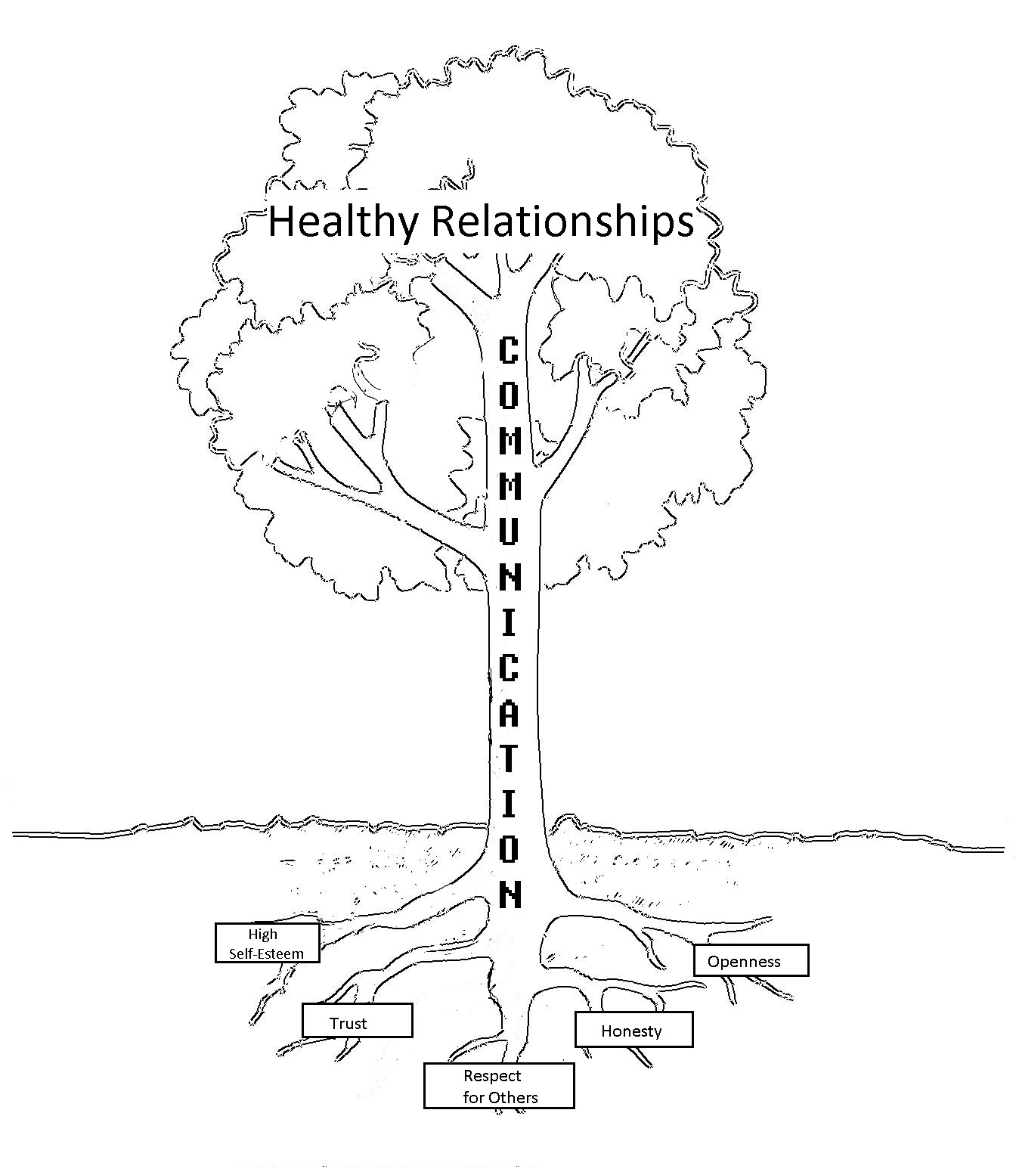
Ok, So What?!
Let’s talk relationships
  Like the tree, our relationships can be explained using the parts of a tree
    Roots: the relationship tree, the roots represent the five main characteristics that we need to possess to nurture a healthy relationship. These five roots are “High Self-Esteem,” “Trust,” “Respect for Others,” “Honesty” and “Openness.” Without these five qualities, we are unable to form and nurture an intimate healthy relationship with others, as well as receive and nurture these qualities in ourselves.

Slide 8
Ok, I guess…
Let’s talk relationships – some more
  Trunk: represents communication.
    Communication, like the trunk of the tree, is a
    two-way flow of information.
    Communication is the means by which different skills
    are used to share information with another individual
    (or groups of individuals). These can be done through
    several means:
    verbal (face-to-face, telephone, radio or television and
    other media)
    non-verbal (body language, gestures, how we dress or
    act – even our scent)
    written (letters, notes, emails, books and magazines)
    electronic (texting, emojis, social media and hashtags)..

Slide 9
Huh…that makes sense…
Let’s keep talkin' relationships
Foliage: represents the relationship
that has grown as a result of the
nurtured roots, soil and trunk
  In nature, the leaves play the role of cooling
  the tree down, remove carbon dioxide (CO₂)
  and release oxygen (O₂) into the air.
  Similarly, when we are in relationships we
  remove loneliness, sadness (at times) and
  the need to be in relationship with
  others.
  Healthy relationships also help to
  increase support and the feeling of being
  connected.

Slide 10
All Together
Now

Slide 11
Are We There Yet?!
Recap
  Relationship Quiz – How’d you do?
  Relationship Tree
    Botany Lesson
    Trees ‘R Us
      5 Main Parts to the root of “us”
      Communication – is a 2-Way street!
      Foliage/growth is the result of strong roots and communication
Next Time
  It’s ALL about Power
  No, it’s ALL about Control
  Nope!! It’s really about Equality ;)

