Slide 1

Communication
Skills
Michael Noll Counseling, LLC
Healthy Interactions Group (HIG)

Slide 2

Where To??
The Last Time…
  Trust
  Love Languages
How About Now?
  Communication
    Basics
    5 Types (maybe 6?)

Slide 3
Communicating…yeah!
Remember the Relationship Tree? The Trunk is all about Communication 😉
A large portion of our lives is spent communicating with others
  Sharing thoughts and understanding other's feelings are essential skills for functioning in any society in the world
#1 difficulty that brings people to couples counseling, and is the core of many other issues we all have

Slide 4
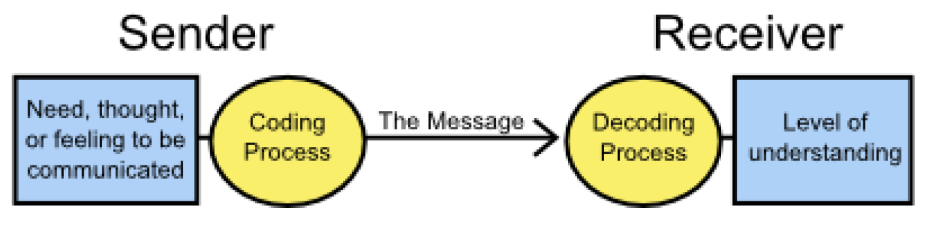
Communication 101
Here’s a simple model of communication that can help illustrate how communicating with others actually goes, the places it goes wrong, and what we can do better:
Necessary: sender, a receiver, and a message
  For human communication, each person has the added step of either coding or decoding a message

Slide 5
Problems? Nah…
History:
  The way we encode/decode messages is based on how we learned to communicate in earlier stages of life
  Every person may have a slightly different understanding; It may depend on culture, family patterns, and other experiences
  Problems can occur at any step of the model, because no two people have had exactly same life experiences

Slide 6
Problems? Of Course Not!
Sender Problems:
The most common problem that we can make as senders is coding the message (thought, feeling or need) in a way that has a low chance of being understood by the receiver (the other person(s))
  Choosing the best way to code your message is important to make sure the receiver understands your message (especially if we do not understand them ourselves)

Slide 7
Problems? Nah!
Receiver Problems:
The biggest problem that happens when we receive messages is in decoding things inaccurately
  1) not paying attention to the sender
  2) not having the skills necessary to decode the message
  3) adding your own meaning to the message that was not really intended by the sender

Slide 8
Do it Better!
1. Be Aware of your communication errors
We are all susceptible to sending confusing messages and “missing the boat” in terms of what someone else was trying to tell us
When we are aware that we all can make mistakes in communicating, we can adjust how we send and receive messages

Slide 9
Do it Better!
2. Choose your words (and actions) wisely based on who the receiver is
As much as we would like for others (our partners, parents, employers, etc.) to automatically know what our needs and/or feelings are, or they interpret all of our questions and comments with accuracy, they can’t
We can become better senders by thinking about how the specific person, at the specific time, would receive a message, and then deliver it in that form

Slide 10
Do it Better!
3. Check in with the sender when decoding messages - to make sure you have the right understanding
After hearing something, especially if it strikes you as off, ask the sender if you are hearing it correctly, rather than trusting your interpretation alone
Think about how many arguments can be prevented with just this!

Slide 11
5 (or 6?) Types
How do we communicate?
Verbal (Oral)
Advantages: Quick feedback; ability to interpret tone; may have a personal touch
Disadvantages: Cannot think deeply about what you are saying; no record; need effective listening skills
Non-Verbal
Advantages: Can quickly provide feedback (positive or negative); more reliable than spoken words
Disadvantages: Can’t take it back; may be misinterpreted

Slide 12
5 (or 6?) Types
Written
Advantages: Can edit over and over; records are able to be saved
Disadvantages: No instant feedback; time to compose may take a long time; may be misinterpreted; saved – could be used against you
Visual
Advantages: emotions, engagement and efficiency may be enhanced
Disadvantages: emotions may be triggered; potential for misinterpretation, oversimplification or accessibility issues

Slide 13

5ish Types
Formal
Advantages: establishes procedures and ensuring that the steps are followed; promises or any official plans need to be formally documented so that they can be referred to later
Disadvantages: Need to follow rules that were established; may be slow or rigid; may cause delays
Informal
Advantages: “Open door policy” (makes people more confident and forthcoming with their ideas and creativity); does not incite fear into people's mind; talking may help others to share their problems
Disadvantages: may be unreliable; rules are made to be broken

Slide 14
Done Already?!
Recap
  Communication Skills
    Basics
    Types
Next Time
  Communication Styles
  Conflict Resolution
  Theres a quiz to take ahead of time on the website

