Slide 1

#Boundaries
Michael Noll Counseling, LLC
Healthy Interactions Group (HIG)

Slide 2

Where We Going Today??
Last Time:
  Codependent (Self-Love Deficit Disorder) is a person who lets another’s behavior affect them and who is obsessed with controlling them (Beattie, “CoDependent No More”)
  They enable their Emotional Manipulator partner’s unhealthy behaviors
  They may be known as: Pushover, Doormat, People Pleaser or the “one who gave the drunk a drink”
  Often seek out an Emotional Manipulator to fulfill their own needs of being able to give/receive: Love, Care and Respect (LRC)
  They are addicts, themselves, although they are addicted to Self-Oriented partners.
This Time: Boundaries
  What are they?
  Why do we care?
  Types
    Physical, Emotional, Intellectual, Sexual, Material and Time
  Barriers
  Tips

Slide 3

Say What?!?
A Boundary is a guideline, rule or limit created to identify what is safe, reasonable or permissible for other to behave around us, and how we will respond if they break them.
            Why is it important to set boundaries?
              To practice self-care and self-respect
              To communicate your needs in a relationship
              To make time and space for positive interactions
              To set limits in a relationship in a way that is healthy
            Personal Boundaries:
              Define what types of communication, behavior and interactions are acceptable to you

Slide 4
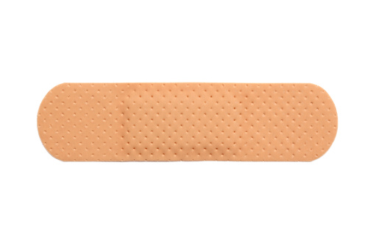
Other Types?!?
Physical Boundaries?
Boundary Invasions
These provide a barrier between you and others (who may do harm) like a band-aid protects a wound from bacteria
Includes
    Body
    Personal Space
    Sexual Orientation
    Privacy
Inappropriate touching: such as unwanted sexual advances
Looking through others’ personal files and emails
Not allowing others their personal space (i.e. barging into your boss’s office without knocking)

Slide 5

More Types
Emotional and Intellectual Boundaries
Boundary Invasions
Protect your sense of self-esteem and ability to separate your feelings from others’
Includes
  Beliefs
  Behaviors
  Choices
  Sense of responsibility
  Ability to be
  intimate with
  others
Not knowing how to separate your feelings from your partner’s and allowing their mood to dictate your level of happiness or sadness (a.k.a. codependency)
Sacrificing plans, dreams, and goals in order to please others
Not taking responsibility for yourself and blaming others for your problems
With weak emotional boundaries, it’s like getting caught in the midst of a hurricane with no protection
  Expose yourself to being greatly affected by others’ words, thoughts, and actions and end up feeling bruised, wounded, and battered

Slide 6
What’s Holding You Back?!?
Barriers to Setting Boundaries
Healthy Boundaries Allow Us To
FEAR
  of rejection and/or abandonment
  of confrontation
GUILT
We were not taught healthy boundaries
Safety Concerns
Have healthy self-esteem and self-respect
Personal information is shared gradually, in a mutually sharing and trusting relationship
Protect physical and emotional space from intrusion
Have an equal partnership with shared responsibility and power
Be assertive: Confidently say “yes” or “no” and be okay when others say “no” to you
Separate your needs, thoughts, feelings, and desires from others
  Recognize that your boundaries and needs are different from others
Empower you to make healthy choices and take responsibility for #1

Slide 7
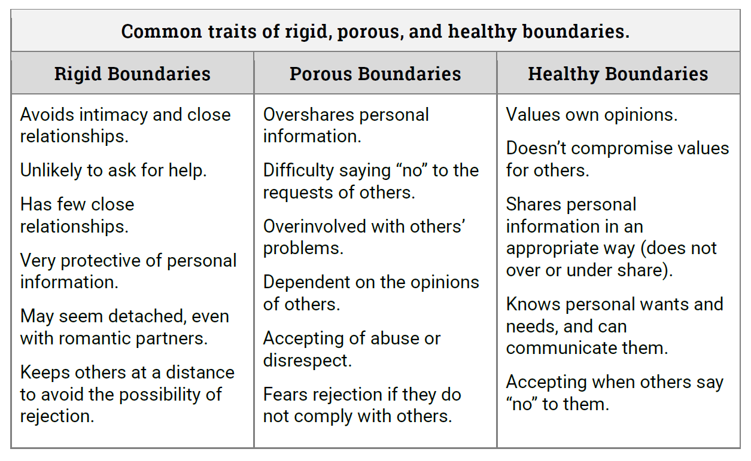
Let’s Explore Some Traits

Slide 8
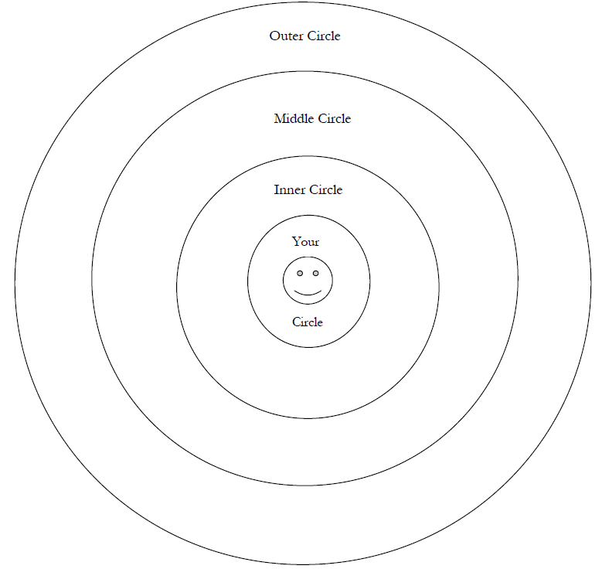
Exercise: Who’s In Your Circle?
How do you decide who gets to be in your inner circle?
Are you in people’s inner circles but they are not in yours?
When does a person move from one circle to another?
What kind of information do you share with those in the outer circle, middle circle, and inner circle?
How much time or energy do you spend on a person in the middle and outer circles?
What are the characteristics of the inner circle people?
What is something that would automatically move someone to the outer circle?

Slide 9
Let’s Do This!
Need a Boundary?
Do!
  Be Clear
  Be Calm
  Be Firm
  Be Respectful
  Use As Few Words
  as Possible
Don’t!
  Justify
  Get Angry
  Apologize
Know!
  If they’re upset
  – it’s on them
  Prepare to be challenged
  – remain firm
  Match your behavior with
  the boundary you are
  attempting to set

Slide 10
All Done?
Recap:
Boundaries
  What are they?: Physical, mental, emotional or psychological limits set to keep us “safe”
  Why do we care?: Keep ourselves from being harmed
  Barriers: Fear! With a capital “F” and Guilt with a capital “G” – although I believe Shame is a big part of what keeps us stuck
Next Time:
Boundaries – again
  How do we set them?
  How do we keep them?
  What happens when they are crossed?

