Slide 1

#Anger?
-or-
Behavior!
Michael Noll Counseling, LLC
Healthy Interactions Group (HIG)

Slide 2

Where To…??
Last Time
  Mindfulness: Eating one Skittle, M&M, Raisin, etc…
  Anger – WTF is that?!
This Time
  PayOff?
  How do you get there?
  ABCDE
  Anger Log

Slide 3
Let’s Get Paid
What are your payoffs – getting angry/aggressive
  Reduce Stress
  Hides Emotional Pain
  Gets Attention
  Punishment and Revenge
  Helps to Change Others

Slide 4
How we get there
It’s a 2-Step Process
  Experience of Pain
    Physical or Emotional
      Stomachache/fatigue, feeling of rejection/loss
      Something that threatens your feeling of safety
    A.K.A. Fuel of anger
  Trigger Thoughts
    Make you feel like the victim
    Thoughts “blame and condemn others”

Slide 5
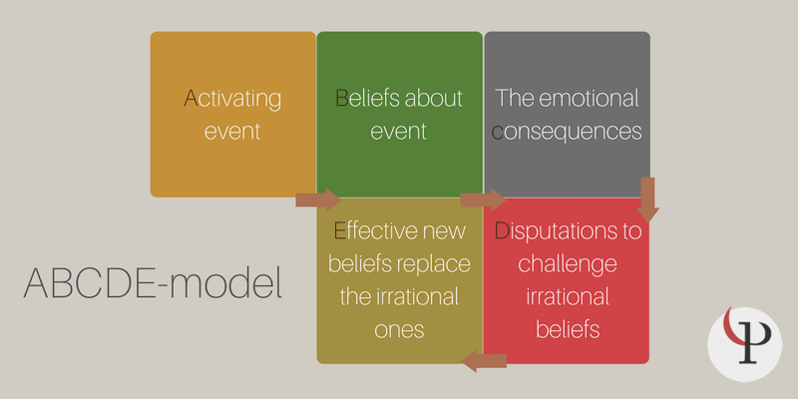
ABC’s

Slide 6
Anger Log
Tool that allows us to learn more about how we respond to pain/triggers
Pain/Stress | Provocative Situation | Trigger Thoughts | Anger Rating 0-100 | Behavior | Outcomes -10 to +10
Feeling Frustrated and hurt | Barry refuses to finish cleaning up living room during Sat morning family clean-up | Defying me, trying to upset me. I’ve had enough of his lazy shit. | 75 | Yelled and physically pulled him back into the living room | -7 I was disgusted with me for losing it | -7 He pouted the rest of the day
Have a headache; feeling frustrated | Ordered clothes from catalog – came in wrong size | Stupid, careless people | 60 | Yelled at order clerk; called her a jackass | -2 felt better for a moment, then depressed – lost control easily | ??

Slide 7
Wrap It Up!
Recap
  How do you get paid?
  How do you get there?
  ABCDE Model
  Anger Log
Next Time
  More Anger
    Relaxation Stuff
    Trigger Thoughts

