Slide 1

#Grief - Week 2
Michael Noll Counseling, LLC
Healthy Interactions Group (HIG)

Slide 2

Where Today??
Recap Last week:
  Grief
    What does it mean?
    Typical Responses
    Some Stats
    Misinformation
    What helps?!
This Week:
  What’s the problem with stages?
  Some Cultural History
  Some Worksheet or Something Like it

Slide 3
What’s the problem with stages?
These were Elizabeth Kubler-Ross’ “Stages of Death and Dying”, not Grief
- Denial, Anger, Depression, Bargaining and Acceptance
2. Stages have a start and end, and if these were the “grief stages” we would get through them, and be done…but, many will re-experience them multiple times

Slide 4
What’s the problem with stages?
3. The “stages” described are emotional behaviors, we may experience some of these, or even repeat them, rather than go through in order
4. A lesser known definition of “stages” comes from "Living With An Empty Chair - a guide through grief.“
- Temes describes three particular types of behavior exhibited by those suffering from grief and loss.

Slide 5
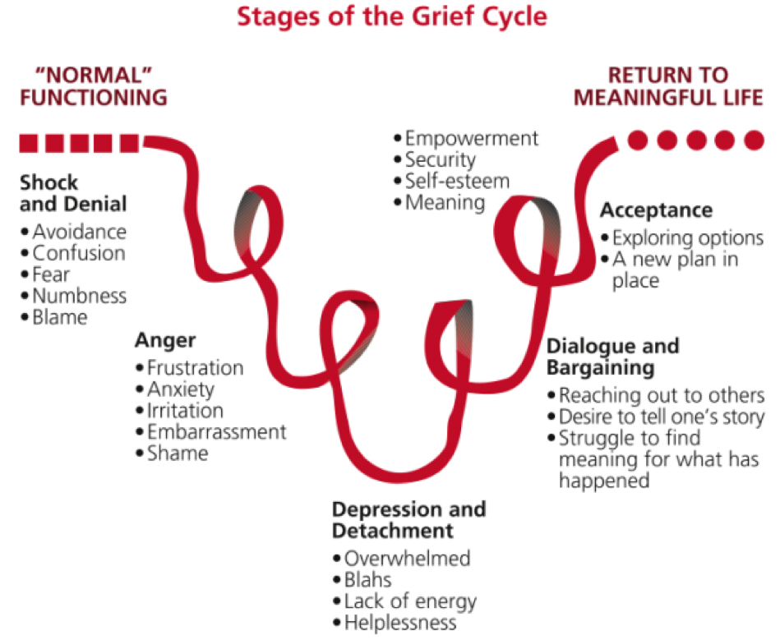
What’s the problem with stages?
Stages of Death
and Dying

Slide 6
What’s the problem with stages?
Temes’ Stages – “Living With An Empty Chair – a guide through grief”
Numbness (mechanical functioning and social insulation)
Disorganization (intensely painful feelings of loss)
Reorganization (re-entry into a more 'normal' social life.)

Slide 7
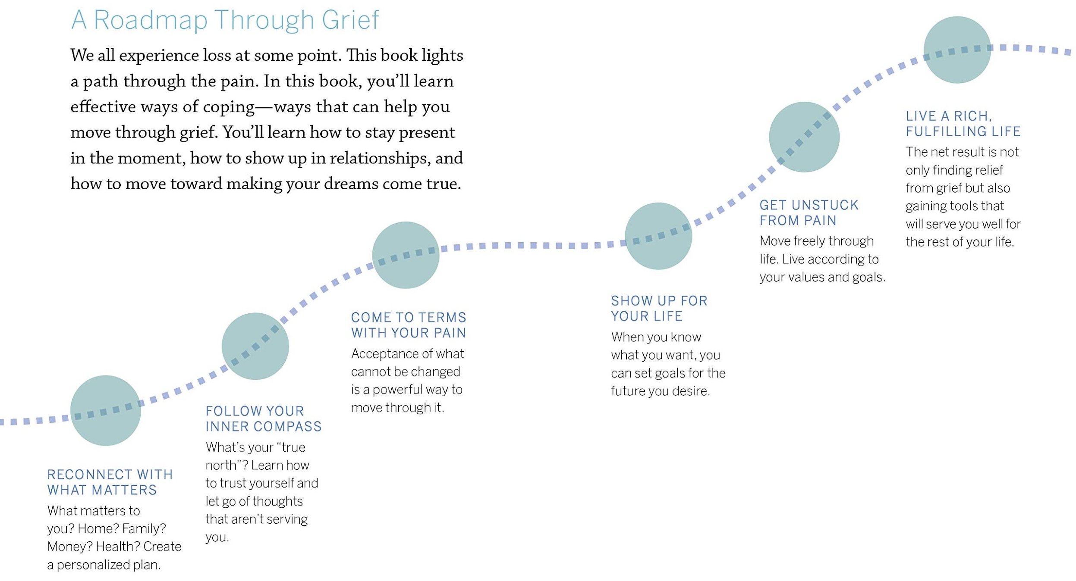
What’s the problem with stages?
Dr. Gretchen Kubacky’s
“Moving Through Grief”

Slide 8
Questioning the Stages…
Will I Go Through Every Stage?
If a 98-year old grandfather died in his sleep I think there would be different emotional reactions to the loss, than if a two-year old child were run over by a car and killed.
If a person has had a long life, death is somewhat expected as the natural scheme of things. There will be emotions of grief and loss but they might be more for what we will miss. If a young life is cut short unexpectedly, there may well be feelings of denial, anger, bargaining, depression, and in some cases acceptance.
Today we are unfettered by these restrictions and might even be confused about when we should be done grieving. Actually, we'll probably never be done.

Slide 9
History
When Will I Be Done Grieving?
Grieving used to be much more ritualistic than it is today. In generations past there were set periods of time when certain customs must be observed:
  Widows wore all black clothing for one year and drab colors forever after
  Mourners could not attend social gatherings for months
  Laughter and gaiety were discouraged for weeks or months
Irish
Hmong
Other?

Slide 10
Worksheet or Something…
Grief Sentence Completion
Right now, I feel...___________________________________________________
I feel the saddest when... ...___________________________________________
The thing I miss the most about the person who I lost is... ...________________
Since the loss, things have been different because... ..._____________________
My family usually feels... ...____________________________________________
If I could ask the person I lost one thing, I would ask... ...__________________
My worst memory is... _______________________________________________
Something I liked about the person who I lost was..._______________________
One thing I learned from the person who I lost is...________________________

Slide 11
Done Already?
Summary:
  What’s the problem with stages? (3 of them?!)
  Questions Grievers Have
  Some Cultural History
  Some Worksheet or Something Like it
Next:
  Forgiveness and Letting Go…

