Slide 1

#Codependency
(Self Love Deficit Disorder):
Week 2
Michael Noll Counseling, LLC
Healthy Interactions Group (HIG)

Slide 2

Where We Going Today??
That Time
  CoDependency
    Origins
    Definitions
This Time
  Review Some Terms
  Story of Narcissus (4 of them? 😮)
  The Human Magnet Syndrome

Slide 3
Terms
Codependency
  Origins: Co-Addict, as it was call in AA (Alcoholic’s Anonymous) to label partners, and ultimately family members, who “gave the drunk a drink”
  Self Love Deficit Disorder: What CoDependency should be called, especially if it were a diagnosable mental illness
  What it is: Addiction to behavior, people or things; where someone finds their identity in the person or addiction
Narcissus
  A story (or 4) of Narcissism’s Roots
Human Magnet Syndrome
  Continuum of Self
  Continuum of Self Values (CSV) Personality Type Breakdown

Slide 4

Narcissus

Slide 5

Human Magnet Syndrome

Slide 6
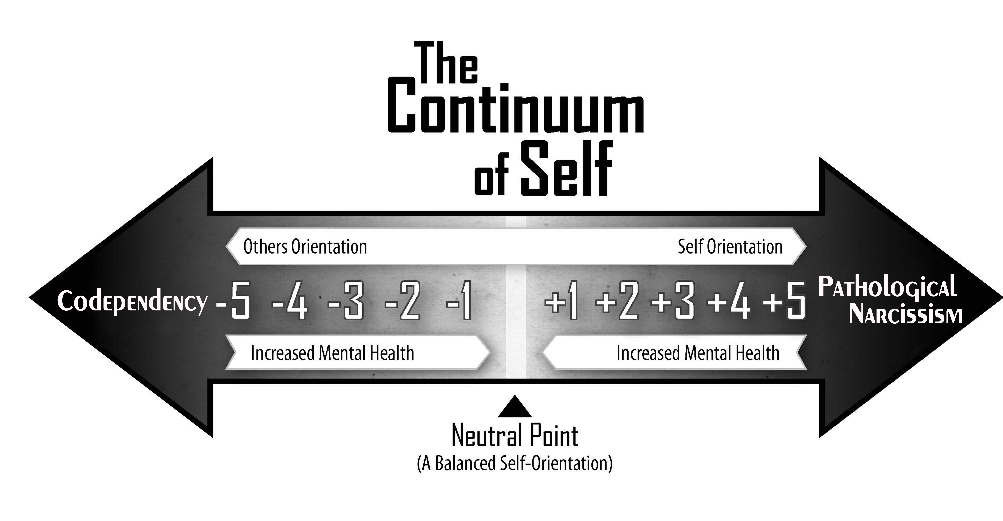

Slide 7
Continuum of Self Values
-5 CSV: A codependent is completely absorbed with the love, respect, and care (LRC) needs of others, while completely ignoring and devaluing their own. This category of individual is often powerless, unable and/or unwilling to seek LRC from his romantic partner.
-4 CSV: A person with codependent tendencies. They are almost always focused on the LRC needs of others while only intermittently seeking to have his own LRC needs reciprocated or fulfilled. This person is able, albeit unmotivated, fearful and/or inexperienced in seeking LRC from his romantic partner. They often chooses not to ask others to fulfill his LRC needs, as they do not want to upset others or cause conflict. If asking for some semblance of LRC from their partner, they do so nervously and with distinct feelings of guilt or neediness.

Slide 8
Continuum of Self Values
-3 CSV: A person who identifies with his caring and giving nature. They are predominately focused on the LRC needs of others, while often diminishing, delaying or excusing away the fulfillment of their own needs. This person’s identity and reputation is fused with their helping/caretaking nature. They are typically in relationships in which there is an imbalance between partner’s and their own LRC needs – giving much more LRC to their partner than receiving. This individual is capable of setting boundaries in relationships while also asking for what they need, however, they tend to feel guilty or needy when setting such boundaries or when asking for help from others.
-2 CSV: One involved in relationships in which his caretaking identity is valued and appreciated, but not exploited. They enjoy relationships with others in which they provide ample amounts of LRC, without wanting equal amounts reciprocated. They are able to ask for what they want/need from others, although it is slightly uncomfortable doing so. They are comfortable with a partner who needs more LRC than they are willing to give in return. They are able to set boundaries and ask for what they need when the LRC balance goes beyond their comfort level. They might experience mild feelings of guilt or neediness when asking their partner to meet their own LRC needs. As much as is possible, they avoids individuals who are narcissistic, exploitative or manipulative.

Slide 9
Continuum of Self Values
-1 CSV: A person with a healthy balance between loving, respecting and caring for self and others. They typically seek life experiences and relationships in which they are able to satisfy their own LRC needs. They tends to participate and appreciate relationships that are based on a reciprocal and mutual distribution of LRC. Although they derive meaning and happiness when helping and caring for others, they do not tolerate a selfish or self-centered romantic partner. They often enjoy caring for others, but do not identify themselves as a caretaker or helper. They do not experience guilt or feelings of neediness when asking for LRC from others.
0 CSV: A person who participates in relationships where there is an equal distribution of LRC given and received. They easily ask for what they need from their partners, while being open to their partners LRC needs. With their LRC-balanced relationships, they easily fluctuate between being the recipient and giver of LRC.

Slide 10
Continuum of Self Values
-1 CSV: A person with a healthy balance between loving, respecting and caring for self and others. They typically seek life experiences and relationships in which they are able to satisfy their own LRC needs. They tends to participate and appreciate relationships that are based on a reciprocal and mutual distribution of LRC. Although they derive meaning and happiness when helping and caring for others, they do not tolerate a selfish or self-centered romantic partner. They often enjoy caring for others, but do not identify themselves as a caretaker or helper. They do not experience guilt or feelings of neediness when asking for LRC from others.
0 CSV: A person who participates in relationships where there is an equal distribution of LRC given and received. They easily ask for what they need from their partners, while being open to their partners LRC needs. With their LRC-balanced relationships, they easily fluctuate between being the recipient and giver of LRC.

Slide 11
Continuum of Self Values
+1 CSV: A person with a healthy balance between loving, respecting and caring for self and others. They tend to participate and appreciate relationships that are based on a reciprocal and mutual distribution of LRC. This indiidual values personal and professional goals and ambitions, which they confidently pursue. Although they derives meaning and happiness through the pursuit of his own goals and ambitions, he is also cognizant of the necessity to love, respect and care for his romantic partner. He effortlessly provides LRC to his romantic partner when necessary or requested. He may identify with both the role of a caretaker or helper while wanting to fulfill his own goals and ambitions.
+2 CSV: A person who prefers to be involved in relationships in which the pursuit to fulfill his own ambitions, desires and goals is encouraged and supported. In a romantic relationship, he actively seeks attention, appreciation and affirmation. Although he is a go-getter and may be consumed with “getting the spotlight,” he is willing and able to fulfill his partner’s needs. He is neither exploitative nor selfish. As an individual who is more oriented toward his own LRC needs, he periodically forgets about the inequity of LRC distribution in the relationship. He responds favorably and non-reactively when his partner asks for higher levels of LRC. Although he can be comfortable in a caretaking role, he doesn’t maintain it.

Slide 12
Continuum of Self Values
+3 CSV: A mildly selfish and self-centered individual. He is predominately focused on the LRC needs of self, while often diminishing, delaying or excusing away the fulfillment of his partner’s needs. This person’s identity and reputation is fused with his need for attention, validation and recognition. He identifies with the persona of the go-getter and success-driven individual. He is typically in relationships where there is an imbalance in the distribution of LRC needs, expecting or taking more LRC than giving. If confronted about the LRC inequality, he may get defensive, but will be able to make corrections. He can modulate or control his self-centered and seemingly selfish attributes. Although he may be perceived as self-consumed and self-centered, he is willing and able to love, respect and care for his partner; they just need frequent reminders.
+4 CSV: A narcissistic individual. This individual is absorbed and preoccupied with the LRC needs of self, while rarely seeking to fulfill the LRC needs of others. They come across as being entitled, self-absorbed and self-centered, as they are driven to seek LRC from others, while giving very minimal amounts of the same in return. They are comfortable with the LRC disparity, believing his needs are more important than his partner’s. Although this person is overtly narcissistic, he is still able to give nominal levels of LRC to others. If confronted about the LRC inequities, he will characteristically get angry and defensive and are quick to justify his actions. He, however, does not experience a narcissistic injury or exhibit narcissistic rage when confronted.

Slide 13
Continuum of Self Values
+5 CSV: An Emotional Manipulator. Unable and unmotivated to love, respect and care (LRC) others. They are consumed with fulfilling their own LRC needs with no intention of reciprocating. They have great difficulty in exhibiting empathy, unconditional positive regard or love. When they do give LRC to others, it is typically conditional, with strings attached. They are unable to comprehend or accept their pathological levels of narcissism. When confronted about the LRC imbalances, they will often strike back with either direct or passive aggression.

Slide 14
Done? Already?!
Recap
  Codependency (Self Love Deficit Disorder) is a person who lets another’s behavior affect them and who is obsessed with controlling them (Beattie, “CoDependent No More”)
  They enable their Emotional Manipulator partner’s unhealthy behaviors
  They may be known as: Pushover, Doormat, People Pleaser and the “one who gave the drunk a drink”
  Often seek out an Emotional Manipulator to fulfill their own needs of being able to give/receive: Love, Care and Respect (LRC)
  They are addicts, themselves, although they are addicted to Self-oriented partners.
Next:
  Boundaries – a.k.a. the cure for CoDependency and Toxic Relationships?

