Slide 1

Communication Skills - Part 2
Michael Noll Counseling, LLC
Healthy Interactions Group (HIG)

Slide 2

Where To Today…??
A Week Ago…
  Communication
    Basics
    5 Types (maybe 6?)
Now…
  Styles of Communication
    4 of them
    What they mean
  “I” Statements (Conflict Resolution)

Slide 3

4 Styles of Communication - #1
Passive:
Avoid conflict; Put’s own stuff aside to support others
Do not often share personal feelings, thoughts or beliefs
  Emotionally dishonest – fear of rejection
Poor Self-Esteem (their needs are unmet)
Feelings:
  Neglected, resentment towards others
Speak quietly
Words/Phrases:
  “maybe”, “probably”, “I suppose”, “kind of” or “sort of”, “I don’t care” or “Whatever” to continue to avoid conflict
Over-Apologizes and unable to accept compliments
Great listeners, but difficulty giving honest feedback

Slide 4

4 Styles of Communication - #2
Aggressive:
Don’t show concern for others feelings, wants and needs – demand their’s are met (usually by manipulation)
Poor Self-Esteem, even though needs may be met
Feelings: guilt and/or shame
Speak loudly or with an unfriendly tone
Words/Phrases:
  “You” Statements to blame/coerce; “you should”,
  “you’d better”
Focus on the negative (or faults) of others
Easily accept compliments, but don’t give them back
Poor listeners, giving feedback as criticism/unwanted advice

Slide 5

4 Styles of Communication - #3
Passive-Aggressive:
Blend of Passive and Aggressive styles
Demand their feelings, wants and needs are met
(like Aggressive)
Appear concerned about others, but only act if it
meets their needs
Don’t tell others what they feel, want or need – expect
others to know
Avoid conflict (Passive)
Poor Self-Esteem; needs unmet/unacknowledged
Feelings: shame and guilt
Voice may be calm when threatening; sarcastic, do not admitting being serious; tell others they’re “too serious”; say “yes” but don’t follow through with their words; give dishonest feedback

Slide 6


4 Styles of Communication - #4
Assertive:
Affirm their rights and those of others
Express feelings, wants and needs – openly and respectfully
Open to hearing other’s express their feelings and needs; willing to compromise
Strong sense of Self-Esteem, Self-Respect and Self-Confidence
Act in their best interest and others, too (compromise)
“I” statements (sometimes )
  “I feel afraid when…” and “I feel angry when…”
Able to admit mistakes (responsible) and successes
This is the Gold Standard

Slide 7

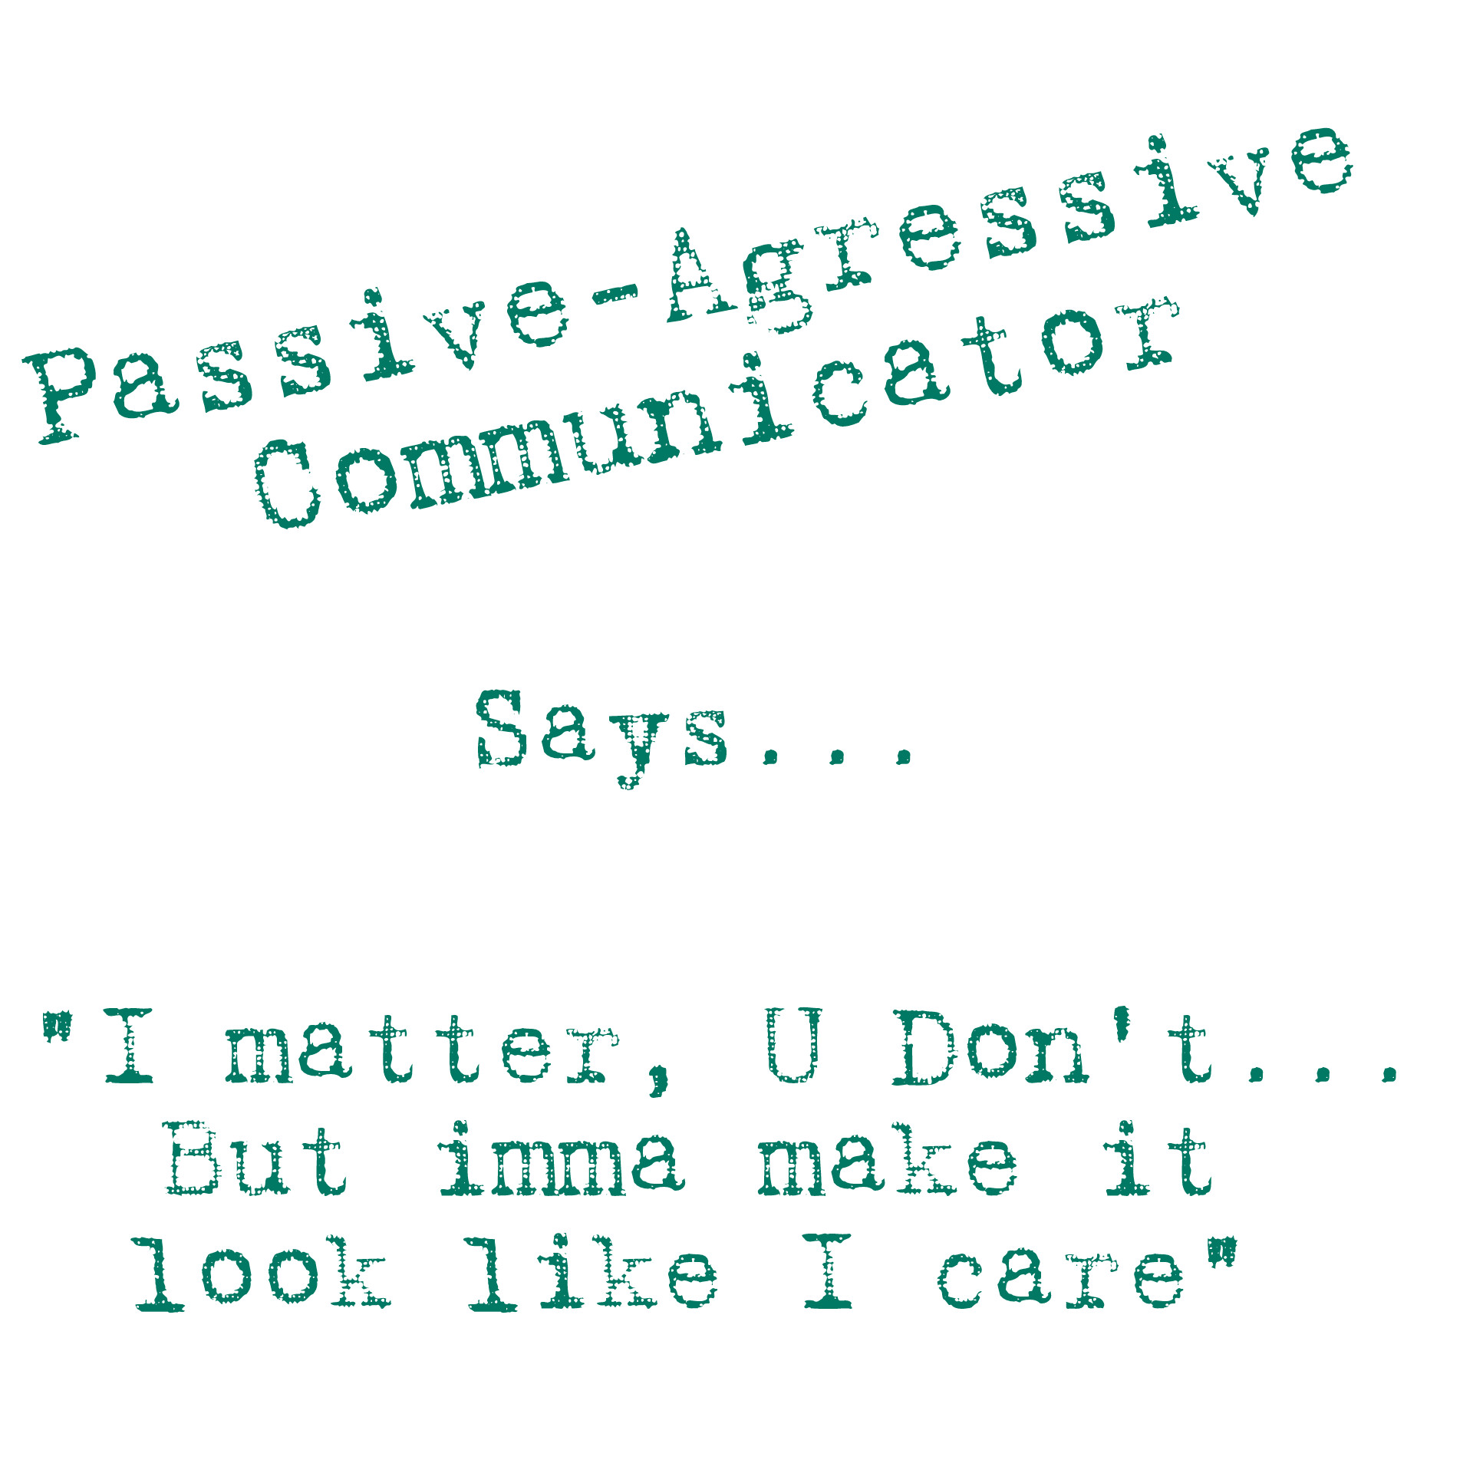
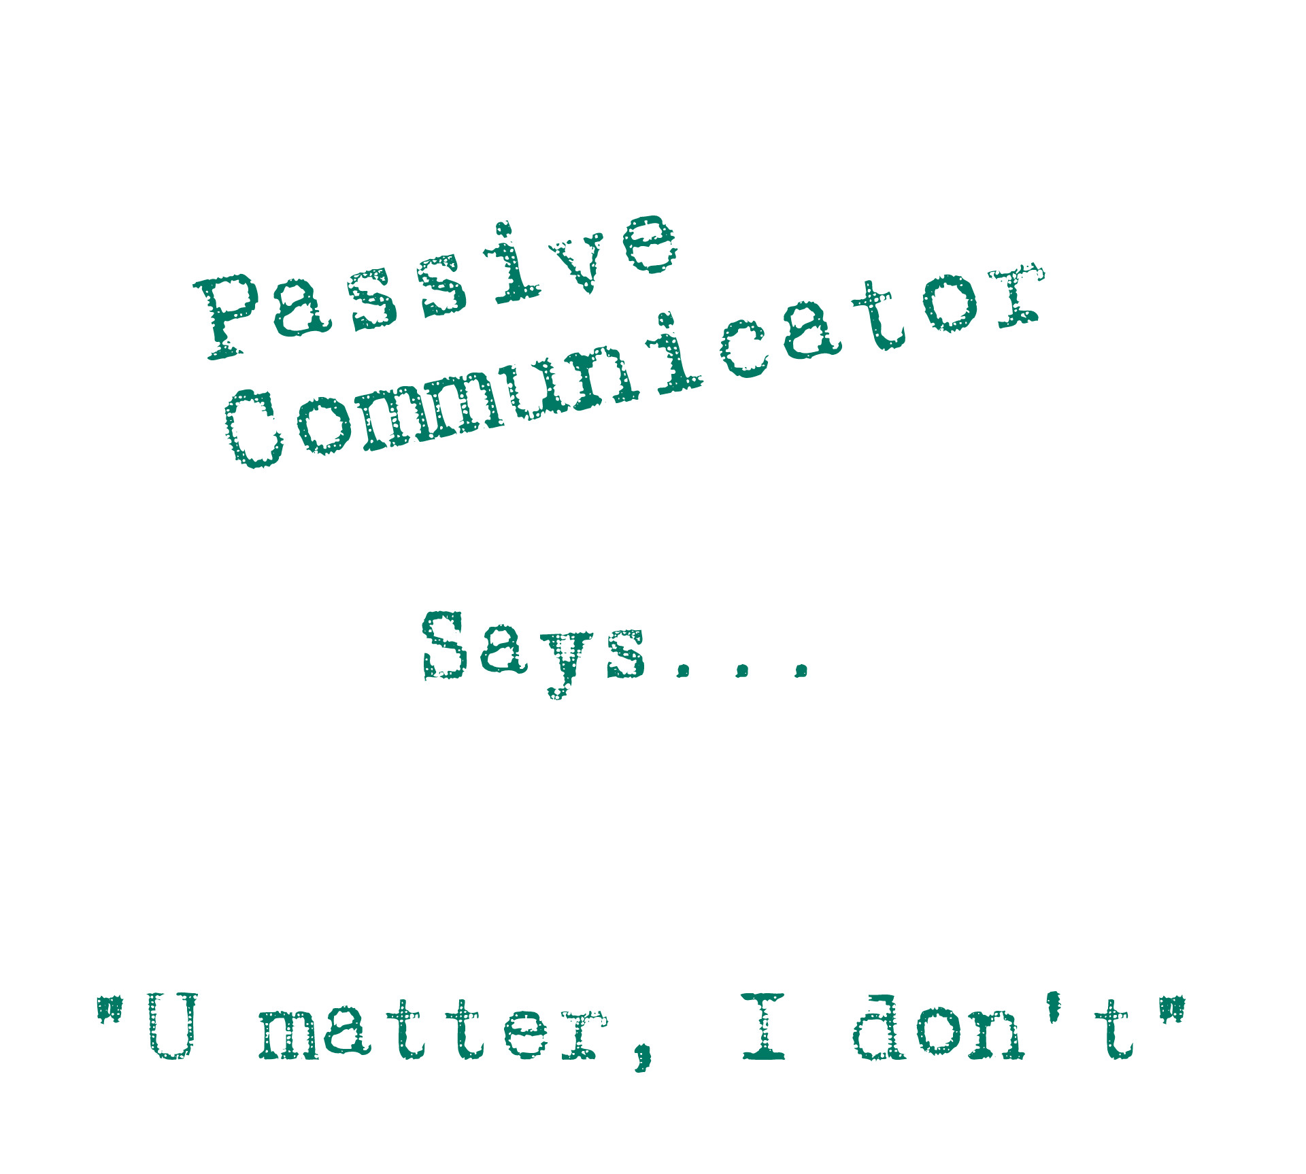
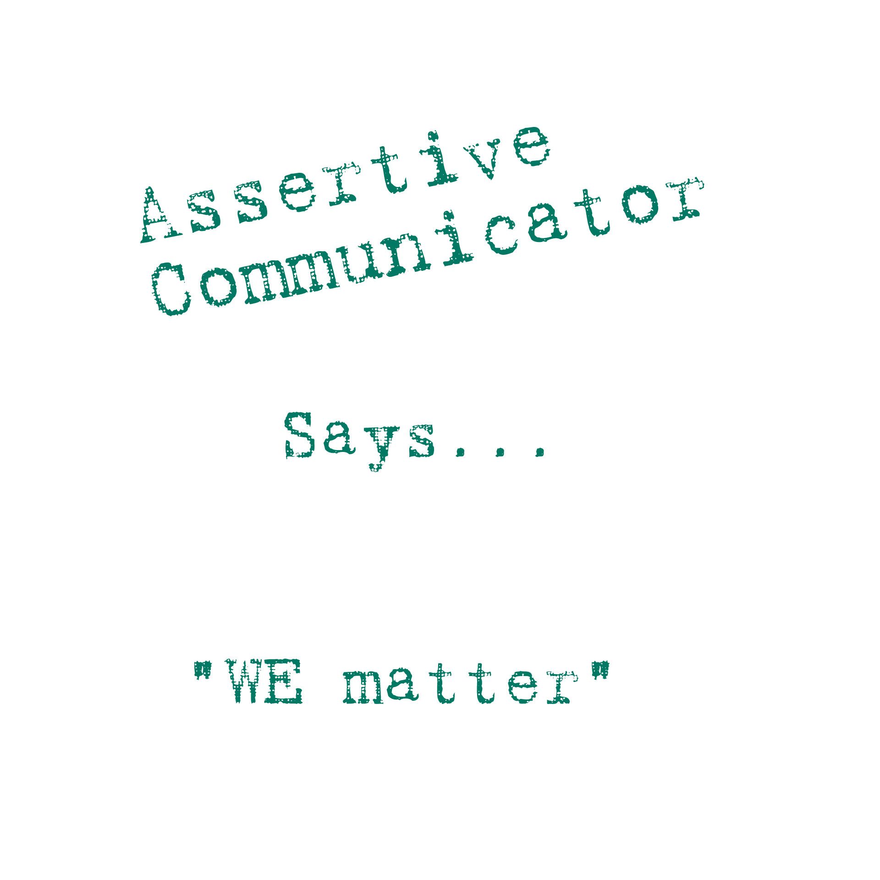
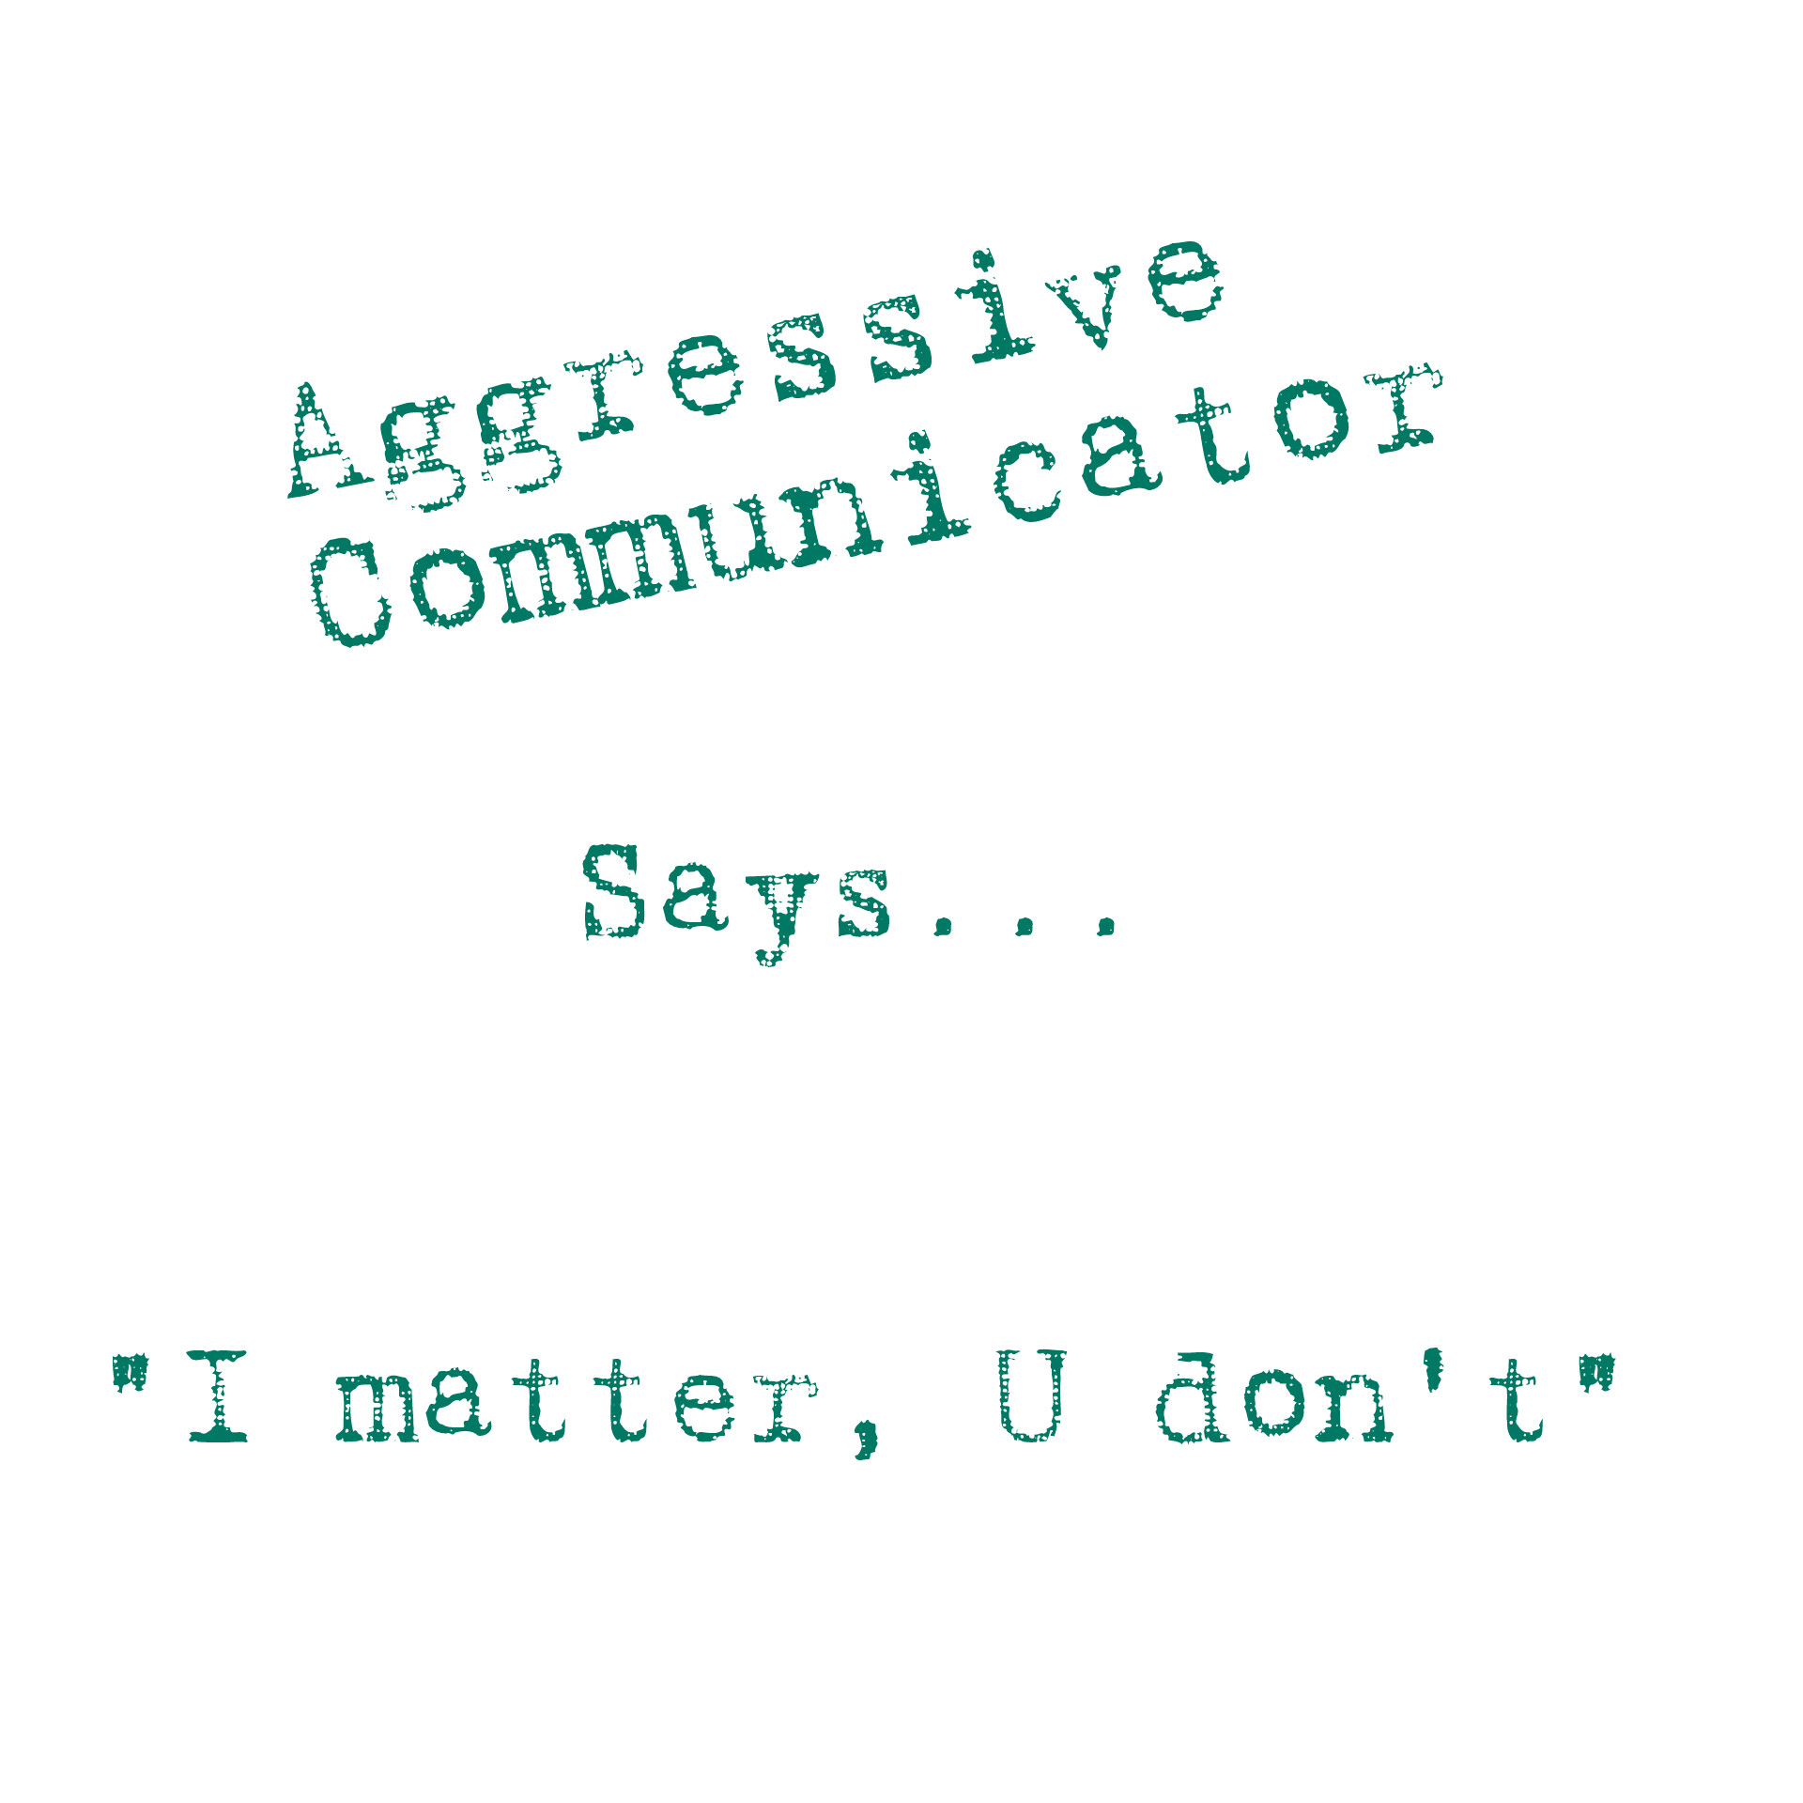
4 Styles (Easy Version)

Slide 8


“I” Statements
Meant to be used to communicate (with honesty and openness) your thoughts, feelings and beliefs
I-statements have four parts. Each part is stated in the following order:
1. "I"
2. What you feel or want
3. The event that evoked/caused your feeling(s) or desire (in a non-offensive way to the receiver)
4. The effect that the event had/has on you

Slide 9
“I” Statements
For example:
"(#1) I feel ____ #2 ________ when _______ #3 ___________,
because ______ #4 ________.
"(1) I feel (2) rushed to leave work (3) when you come in late, because
(4) I have to pay more when I am late picking up my child from daycare.“

Slide 10
Any Problems?
It’s not about how you feel — it’s about why you feel that way. And you feel that way because of something the other person did. Period.
Basically, using “I” statements is a great way to
avoid the discomfort of giving and receiving feedback.

Slide 11
Let’s Fix “I” Statements
Getting Nowhere with “I” Statements?
Alternatives:
Creating a shared note (iPhone/Google doc)
  Write what you need to say, exactly, and leave space for the other person to respond
  You both get time to think before you write your thoughts; responder can process their thoughts before responding

Slide 12
“I” Statements – a Bit Better
More Alternatives:
Schedule a time to talk.
  Tell them you want to have a conversation about __________
  Pick a mutually convenient time to talk -- they won’t be entirely caught off guard by your dissatisfaction.
  Example: “I really want to talk to you about what happened yesterday and why it made me so angry, but we have a really busy day today and I don’t want it to be a stressful conversation. Can we talk about it tomorrow night? I’ll bring ice cream.”
Gives them a heads up, and there’s no need to bring it up again until the scheduled time. Offering to talk over food or to go out afterwards communicates to a defensive partner that this will not be a relationship-ending conversation.

Slide 13

“I” Statements – S’More Fixes
Even More Alternatives
Record a voice message
If written words come across differently than you want (or you
have difficulty saying what you mean) or face-to-face chats
end in arguments, try this one
Take the time to think about what you need to say and record
a short voice message then send or give to the other person
You will both get to “hear” each other, but you both
get the time to process your response

Slide 14

“I” Statements – Seriously?
More Alternatives
Agree to talk for 5 minutes at a time –
no longer.
When discussing deep-rooted problems
(that you think will end in a fight) agree
to break the discussion into smaller chunks
and address a one to 2 points of it each time
Agree that you will talk about uncomfortable subject, but remind yourselves that it will be over in a few minutes
This helps to signify this is NOT a relationship-ending conversation
If your only reaction is “I understand”, consider it a win for now. Take baby steps and acknowledge the progress made in tackling the difficult issue together. Pick up where you left off the next day

Slide 15
“I” Statements – Seriously?
Regardless of the method you choose, don’t forget to:
state how you feel
state why you believe the other person is responsible for you feeling this way (trigger)
state what you need, as a question, or ask an open-ended question if you’re not sure what you need

Slide 16
“I” Statements – Last One, Promise
** Giving and receiving feedback is an integral part of ALL interpersonal relationships.
While “I” statements themselves aren’t terrible, the lack of follow-up discussion and the avoidance of accountability absolutely is. It is naturally difficult to call someone out, and more difficult to be the one who is called out, but navigating through that discomfort is the only way to make sure both of you are heard.
After all, there is a big difference between
“my partner is hurt” and “I hurt my partner”

Slide 17
Done Already?! Err, Finally...
Recap
  Styles of Communication
    4 of them
    What They Mean
    “I” Statements/Conflict Resolution
Up Next
  Self-Esteem

