Slide 1
Healthy Relationships
Healthy Interactions Group (HIG)
Michael Noll Counseling, LLC

Slide 2
Where We Goin’…??
That time…
What’s a Relationship
Quiz
Relationship Tree
This time…
It’s ALL about Power
No, it’s ALL about Control
Nope!! It’s really about Equality ;)

Slide 3
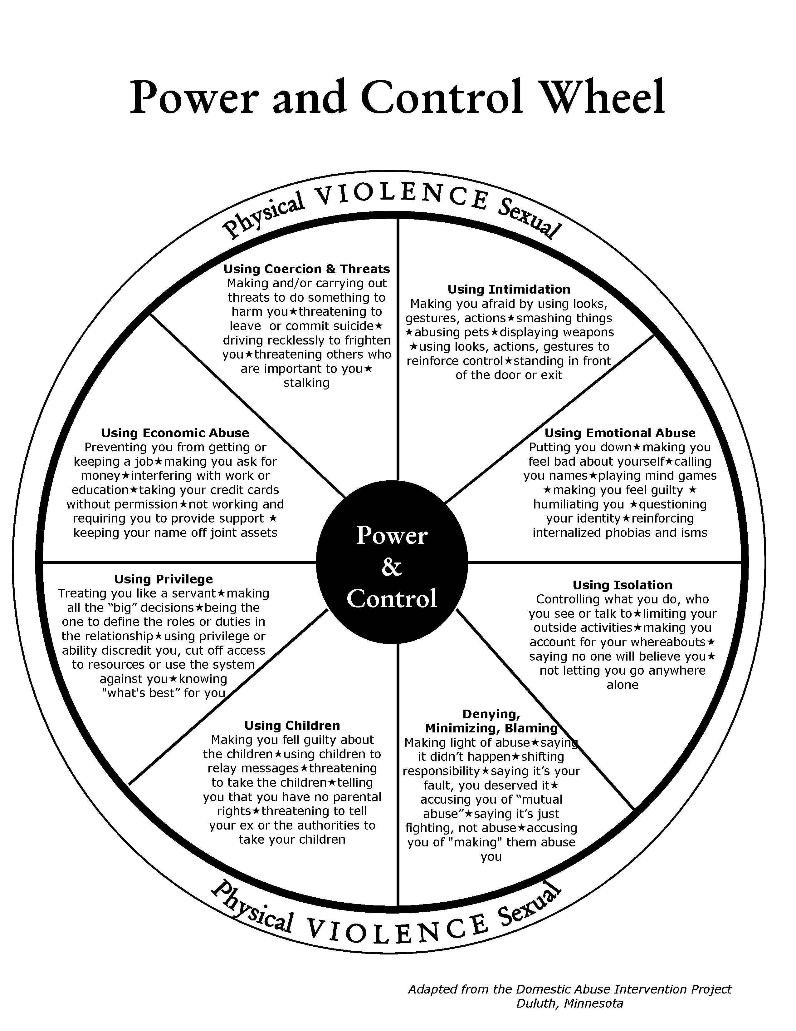
Power/Control
The Duluth Model is the most common batterer intervention program used in the United States. It was developed to reduce male on female violence.
Critics argue that the method can be ineffective as it was developed without minority communities in mind and can fail to address root psychological or emotional causes of abuse, in addition to completely neglecting male victims of abuse
Criticism of the Duluth Model has centered on the program's insistence that men are perpetrators who are violent because they have been socialized in a patriarchy (‘man’s world)’ that condones male violence, and that women are victims who are violent only in self defense.

Slide 4
Power/Control – Problem!
It's a gender-polarizing approach that only serves to perpetrate the "battle of the sexes.“
It's about blaming and shaming men, more than giving them the insights and support to help them stop their abusive behavior.
It ignores drinking, drugs, Borderline Personality Disorder and other serious psychological problems.

Slide 5
Power/Control – Fixed?
There is some truth in this, just not the way the authors originally planned
The updated Power/Control Wheel is not geared only toward men
Intimidation
Making him/her afraid
Smashing things
Destroying Property
Harming pets
Displaying Weapons

Slide 6
Power/Control
Emotional Abuse
Put Downs
Name Calling
Mind Games
Humiliation
Making someone feel guilty
Isolation
Controlling what they do, see, read and where they go
Limited outside involvement
Uses Jealousy to justify actions

Slide 7
Power/Control
Using Children
Feeling guilty about children
Using them to relay messages
Using visitation to harass them
Threatening to take the kids away
Denying, Minimizing, Blaming
Making light of abuse
Saying it didn’t happen
Shifting responsibility
Saying they caused it

Slide 8
Power/Control
Economic Abuse
Preventing partner from getting/ keeping a job
Making them ask for money
Giving allowance/taking money
Disallowing access to family income
Priviledge
Treating partner like a servant
Making all the big decisions
“Master of the Castle”
Defining gender roles
Culture/Religion

Slide 9
Power/Control
Coercian/Threats
Making and or carrying threats to harm you/others
Threatening to leave or commit suicide
Report to “Welfare”
Drop charges
Doing illegal things
Maintenance Behaviors

Slide 10
Equality Wheel
The Equality Wheel was created to show
Non-Violence :
There is no place for violent acts or behaviors in a healthy relationship
Examples of violent acts or behaviors include:
yelling
throwing things
hitting
name-calling
unwanted touching
stalking
pushing
minimizing feelings
forced sex

Slide 11
Equality Wheel
The Equality Wheel was created to show
The Equality Wheel' is a model used to explain the dynamics of a healthy relationship; friends, dating partners, intimate partners, life partners, or family members.
Each component of the wheel supports and reinforces the others; equality always at the center.
Guide to maintaining healthy patterns in a relationship.

Slide 12
Equality Wheel
Non-Threatening Behavior
Talking and acting so that partner feels safe and comfortable expressing themselves and doing things
Respect
Listening nonjudgmentally
Being emotionally affirming and understanding
Valuing opinions

Slide 13
Equality Wheel
Trust/Support
Supporting goals
Respecting their right to own feelings, friends, activities and opinions
Honesty/Accountability
Accepting responsibility for self
Acknowledging past use of violence
Admitting being wrong
Communicating openly and truthfully

Slide 14
Equality Wheel
Responsible Parenting
Sharing responsibility
Positive non-violent role model
Shared Responsibility
Mutually agree on fair distribution of work
Make family decisions together

Slide 15
Equality Wheel
Economic Partnership
Making Money decisions together
Making sure both benefit from financial arrangements
Negotiation and Fairness
Seeking mutually satisfying resolutions to conflict
Accepting changes
Willing to compromise

Slide 16
Done Already?!
Recap
It’s ALL about Power
No, it’s ALL about Control
Nope!! It’s really about Equality ;)
Next Time
Trust
Love Languages

