Slide 1
Healthy Relationships
Healthy Interactions Group (HIG)
Michael Noll Counseling, LLC

Slide 2
Where To…??
Previously in Healthy Interactions
Anger Triggers
Anger & Relaxation
This time…
What’s a Relationship
Quiz
Relationship Tree

Slide 3
Quiz Time
Directions: Indicate who, in your relationship, does the following:
Neither or
Both
One Person
Considers partners likes/dislikes when making plans
Shares things he/she likes about their partner
Supports partner in setting/meeting personal/professional goals
Encourages partner to be the person they want to be/are
Comforts partner when upset, sad, frustrated, etc
Asks for/listens to partner’s point of view (even when arguing/disagreeing)
Respects partner’s need for alone time
Treats partner’s property/belongings well
Treats partner as equal

Slide 4
Quiz Time
Neither or
Both
One Person
Respects online privacy (FB, Insta, email, text, etc.)
Respects decisions around sex
Admits mistakes
Ok with partner spending time with friends/family
Trusts that partner is being honest about his/her actions/activites
Cares if the other person has fun when going out
Communicates respectfully both publicly and privately
TOTAL: Count the number of X’s from the BOTH column only

Slide 5
Did You Win?!
Scores of 0-8: Relationship has room for improvement. To be healthy, both people need to contribute equally. Scores in this range indicate that the relationship is either One-Sided or nobody’s trying very hard. It may work with combined effort and commitment, but it’s probably time for a reality check for you both. Ultimately, ask yourself…”Does this relationship feel good to me?”
Scores of 8-12: Relationship has potential, but may take a good amount of work. If you both want to continue in the relationship, you both need to pick areas to work on in order to create a healthier relationship. Make it shared goal with your partner to increase the amount of X’s in the Both column.
Scores of 12-16: You’re on track for a healthy relationship! These take time and effort, you are both working on it. You have high levels of trust, support, fun, equality and respect. Keep up the good work and remember…”there is always room for improvement.”

Slide 6
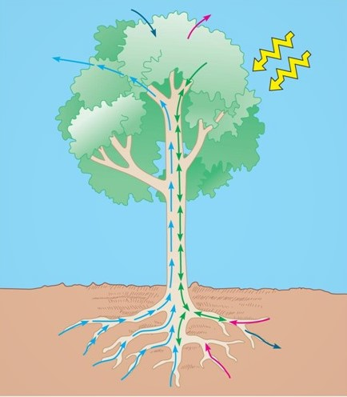
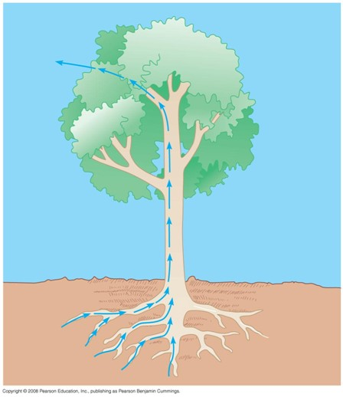
What Can A Tree Tell Us?!
Let’s talk botany
Trees pull water and minerals in through the roots from the soil, which travels up the trunk and out to the foliage (leaves/fruits) and disperses O² (Oxygen) for the world
Photosynthesis – sun shines down signaling the leaves/branches to pull CO² (Carbon Dioxide) in, make sugar and disperse new minerals into the soil

Slide 7
Ok, So What?!
Let’s talk relationships
Like the tree, our relationships can be explained using the parts of a tree
Roots: the relationship tree, the roots represent the five main characteristics that we need to possess to nurture a healthy relationship. These five roots are “High Self-Esteem,” “Trust,” “Respect for Others,” “Honesty” and “Openness.” Without these five qualities, we are unable to form and nurture an intimate healthy relationship with others, as well as receive and nurture these qualities in ourselves.

Slide 8
Ok, I guess…
Let’s talk relationships – some more
Trunk: represents communication. Communication, like the trunk of the tree, is a two-way flow of information. Communication is the means by which different skills are used to share information with another individual (or groups of individuals). These can be done through several means: verbal (face-to-face, telephone, radio or television and other media), non-verbal (body language, gestures, how we dress or act – even our scent), written (letters, notes, emails, books and magazines) and electronic (texting, emojis, social media and hashtags)..

Slide 9
Huh…that makes sense…
Let’s talk relationships – some more
Foliage: represents the relationship that has grown as a result of the nurtured roots, soil and trunk of the tree. In nature, the leaves play the role of cooling the tree down, remove carbon dioxide (CO₂) and release oxygen (O₂) into the air. Similarly, when we are in relationships we remove loneliness, sadness (at times) and the need to be in relationship with others. Healthy relationships also help to increase support and the feeling of being connected.

Slide 10
Are We There Yet?!
Recap
Relationship Quiz – How’d you do?
Relationship Tree
Botany Lesson
Trees ‘R Us
5 Main Parts to the root of “us”
Communication – is a 2-Way street!
Foliage/growth is the result of strong roots and communication
Next Time
It’s ALL about Power
No, it’s ALL about Control
Nope!! It’s really about Equality ;)

