Slide 1
Are You #Stressed?
Healthy Interactions Group (HIG)
Michael Noll Counseling, LLC

Slide 2
Where To…??
Recap:
Guilt vs Shame
Emotion vs Feeling
Same? Different?
Who knows, Who Cares, Why Bother?
Today
Stress, Anxiety and Whatever Else
Stress Curve
Cold Hands, Fast Heart

Slide 3
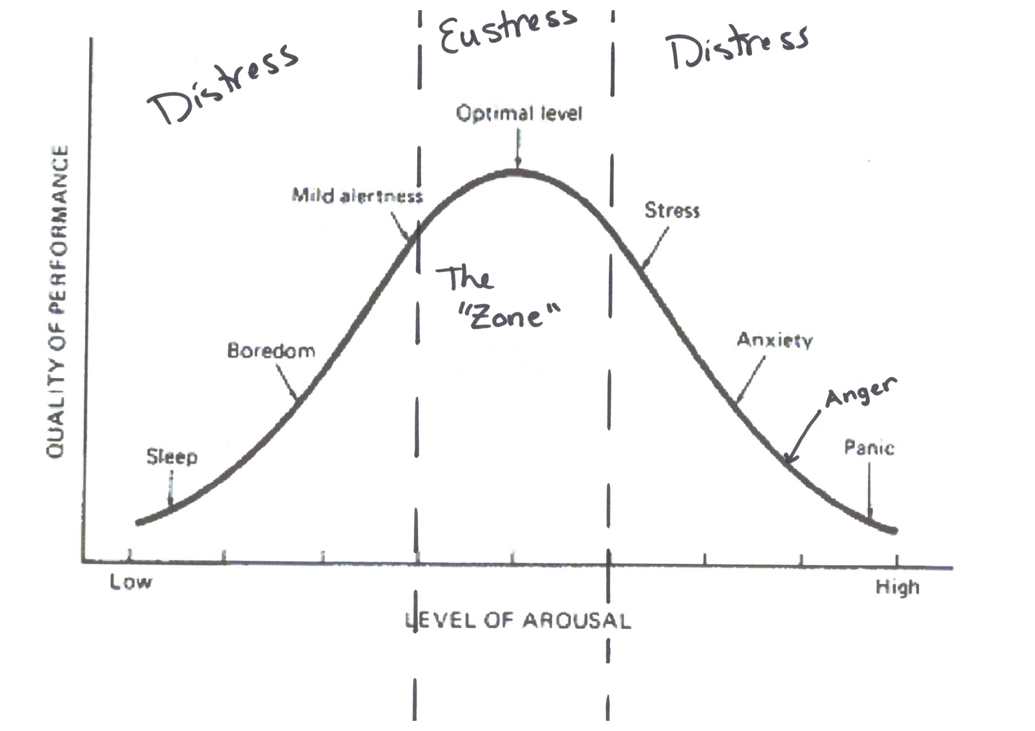
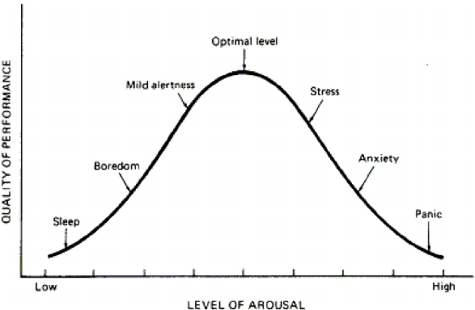
The Curve

Slide 4
Whad’ya say?
Stress, or as it may be referred to “anxiety,” is a normal response to changes that we experience through everyday activities
Usually used to describe negative situations, which has led us to believe that stress is something to avoid
Excessive amount of stress can be harmful to physical and mental abilities
Not always a negative reaction to life
2 Types
Distress is what we usually think of; Negative
Eustress (pronounce YOU-stress) is a positive type of stress. I like to think of eustress as being in the “zone”
The zone is a place where things flow well psychologically, physically and biologically

Slide 5
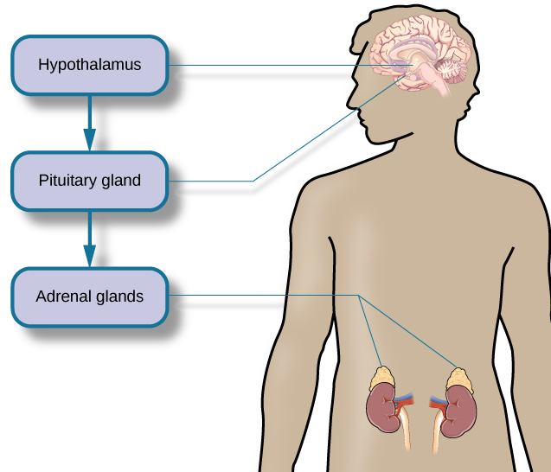
Cold Hands, Fast Heart
The human body instinctively reacts to stress by releasing hormones that control the heart rate and breathing. We’re talking fight or flight—the innate human response to stress.
3 Key Parts of the body control the hormones:
In the brain: hypothalamus (high-po-THAL-uh-mus) and pituitary (pih-TOO-ih-tair-ee) glands
Top of Kidney’s: adrenal (uh-DREE-nal) glands
The hypothalamus signals the pituitary gland that signals the adrenal glands to release the stress hormones epinephrine (ep-i-NEF-rin), norepinephrine (nor-EP-i-NEF-rin), and cortisol (KORT-ti-zol) (increase heart rate and breathing), which provide a burst of energy (to fight or flight), as well as affect other bodily functions.

Slide 6
Who Cares About the Brain?
The Chemicals released may cause a variety of issues (stress/anxiety)
Headaches – not enough blood flowing to the brain (don’t need it when running from a bear)
Hard to Concentrate – short term memory is basically shut-off, cuz you don’t need it, you just need to be able to fight or flee
Dry Mouth, Hard to Swallow – (see headaches); only necessary functions to keep you alive are working in major stress times
Heart Pounding – these hormones speed up the heart rate – again, keep you alive
Nausea/Hangry – hormones do a number on your digestive track (same thing, but seem different)
Hard to Sleep – energy (adrenaline) is keeping you “awake” – needs to be shut down

Slide 7
Wait…Questions?

Slide 8
Are We Done Yet?
That’s a Wrap:
Stress Management
Stress, Anxiety and Whatever Else
Stress Curve
Cold Hands, Fast Heart
Hormones and something else
What’s Next?!
Stress Management – Let’s Manage It Better!

