Slide 1
Is it #Guilt?! or Is It #Shame?!
Healthy Interactions Group (HIG)
Michael Noll Counseling, LLC

Slide 2
Where To…??
Recap:
Forgiveness and Letting Go
Maybe not what you had in mind
The How and Why
Next Steps?
Today:
Guilt vs Shame
Emotion vs Feeling
Same? Different?
Who knows, Who Cares, Why Bother?

Slide 3
What is what?
Feeling? Emotion? Same, right?!
Feeling – has upwards of twenty different meanings, depending on which dictionary you consult
For our purposes, it’s something experienced as a result of outside stimuli (something that causes a change or reaction) reacting with one of your five senses or someone’s sensibilities, attitude, or emotional perception
Emotion – is a state of consciousness in which various internal sensations are experienced
Can be produced by a thought, memory, or external motivator and can often change our physical state of feeling
the biggest difference between feelings and emotions is that feelings have to be triggered by an external motivating factor whereas emotions can be completely internal
Emotions and feelings are both sensations experienced by humans
Feelings are triggered by external stimuli whereas emotions come from your mind, and possibly, soul
Feelings can include physical sensations as well as mental states, but emotions always come from your mind
Feelings are often temporary and subside once the stimulus is no longer present, whereas emotions will stay with you for years because they are seated in your mind

Slide 4
Same? Different?
Guilt:
Experienced when we act against our values
Uncomfortable feeling we experience when we have done something wrong
Based on failure of doing – result of our behaviors/choices
Involves a violation of standards
Negative?
Not always, can be a positive motivator – helps us to change our behavior
Shame:
Feeling like a failure or “I’m bad” at my core

Slide 5
Who knows…
Guilt – 2 Versions
Unhelpful (Unhealthy)
What we often think of as guilt
Helpful (Healthy)
Feeling of discomfort about something we see as wrong – feeling poorly about it
When looking at guilt ask some questions
Whose values were violated?
Who created those values?
Our values can be different?

Slide 6
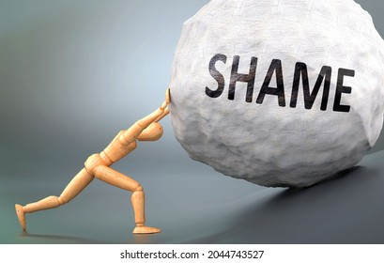
Who Cares…
Shame:
Feeling of inferiority – feeling “flawed”, “unworthy” or “not good enough”
Self-blame – directly linked to self-esteem
Fear of rejection
Disconnecting from others and self

Slide 7
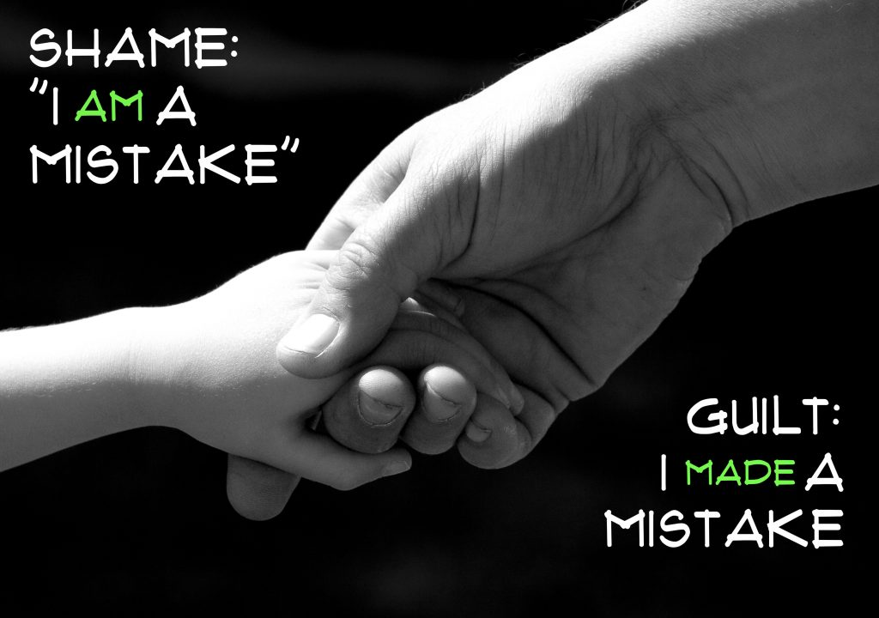
Whoa…
Guilt, experienced as early as 3-6 years old
Shame, as early as 15 months (more deeply ingrained), Formed in childhood, as early as 15 months, in families where negative messages are received (put-downs and/or insults)

Slide 8
Why Bother? (Dealing with guilt)
Face the feelings of guilt. Release feelings of guilt by talking about them, sharing, confessing, getting honest
Learn to forgive yourself – Do you judge yourself too harshly?
Examine the origins of your guilt – Is the reason that you feel guilt rational and reasonable?
Inappropriate or irrational guilt involves feeling guilty in relation to something that in reality you had little or nothing to do with
If something you are doing is causing you to feel guilty, then stop doing it and you will no longer have a reason to feel guilty any longer
Clarify new values for yourself and take realistic action in the present instead of dwelling on the past. Think about positive action you can take in your life now to feel better. What can you do to improve things going forward?

Slide 9
Why Bother? (Still dealing with guilt)
Practice forgiving others, helping others and doing good for others.
Learning to empathize and forgive others can help you to learn to forgive yourself
Apologize or just seek peace.
Is there something you can say or do in order to try to show that you are willing to make peace where there has been hurt, conflict, or disagreement?
Let go
If you are truly remorseful over something you have done wrong in the past and you tried to make peace or amends, you can still forgive yourself even when others do not forgive you.
If someone who hurt you is sorry, learn to let it go yourself so you can forget about the hurt and then focus on moving forward
Was there a legitimate cause for your past actions that was beyond your control at the time?

Slide 10
Why Bother? (Still dealing with shame)
Strengths and Qualities List (3 things each)
Things I’m Good At
Compliments I’ve Received
What I like about my appearance
Challenges I’ve Overcome
I’ve helped others by
Things that make me unique
What I value the most
Times I’ve made others happy
Core Beliefs
What is one of your NEGATIVE core beliefs about you?
List three pieces of evidence contrary to your negative core belief

Slide 11
Are We Done Yet?
That’s a Wrap:
Guilt vs Shame
Emotion vs Feeling
Same? Different?
Who knows, Who Cares, Why Bother?
What’s Next?!
Stress Management

