Slide 1
#Thought Mapz
Healthy Interactions Group (HIG)
Michael Noll Counseling, LLC

Slide 2
Where Today??
Recap Last week:
Values
What are they?
Why should I care?
Vs. Goals? Aren’t they the same?
Activity
Thought Mapz or Cognitive Model
Say Again?
Why should I care?

Slide 3
What’s a Map For?
What’s a map?
Visual representation of land
Set of instructions
Way to communicate a sense of place
Types of Maps
Reference
show the location of geographic boundaries, physical features of Earth, or cultural features such as places, cities, and roads
Political, Physical, Road Maps, Topographical, Time Zone, Geological and Zip Code
Theme based or Thematic
show the variation of a topic (the theme) across a geographic area.
Weather, income or resource type
What do we use maps for?
Find our way
Understand where we are in relation to where we want to go

Slide 4
What’s a Thought Map?
…set of instructions used to tell us where to go or not go, how to do something (including being silent), the five senses (sight, hearing, taste, touch and smell), intuition and a set of instructions needed to control impulses
We use Thought Maps every day for many different purposes. For example:
Choose which food to eat
How we should react to other drivers
When/how to speak our opinions (with or without a “filter”)
Formed early in development (possibly in-utero)
As they form, instructions are created for virtually every event and stored for later to be accessed when faced with a similar event (future)

Slide 5
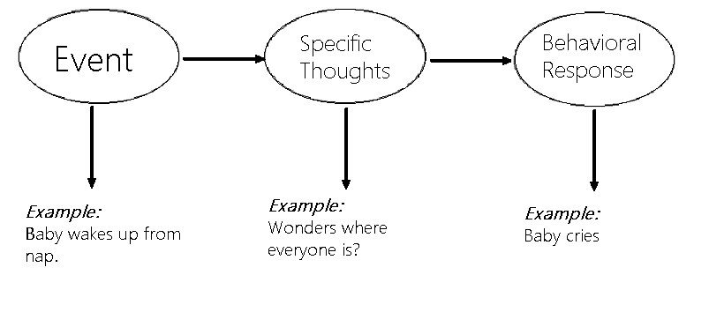
A Simple Thought Map?
Event: Baby wakes up from nap
⇒ Thought: I am hungry; I want comfort; “Where is everyone?”
⇒ Action: Cries
Event: Baby is crying (was the action of the child)
⇒ Thought: Child is hungry; child needs comforted; child’s diaper is full
⇒ Action: Attends to the child’s needs (bottle, holds child – comforting them; changes diaper)
In response to the child crying, its’ parent (mom, dad or caretaker) has their own thought map activated:

Slide 6
Okey?
Facts:
Each event (situation) can kick off 1 or more thought maps
May create a new thought map, if you haven’t experienced the situation before
These thought maps are used to help us to quickly determine how to react in situations
A Story:
What happened in this story? Did it have to happen this way?
Why did it happen in this fashion? What did you notice about our answers
Details of the story aren’t important, it doesn’t matter if they normally act or react this way, as their thinking pattern is part of them. It makes up a large portion of their personal thought maps. In this case, the individual is being asked to do something that they do not want to do.
Were you able to state just the facts about the event or did you express your judgments and opinions of the event, like many of us do?

Slide 7
Wait, Something’s Missing?
Recap:
What’s missing?
Capital “F” – Feelings
According to the Cognitive Model, Feelings don’t have a place?

Slide 8
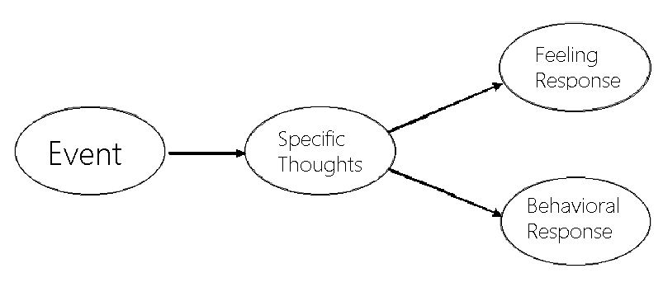
How Do Feelings Fit In?
Feelings do not play a direct role in the resulting behaviors.
Did you notice that the feelings were missing from the scenario about the baby crying?
Feelings, like actions, are a result of the thoughts.
Events triggers thoughts and, in turn, we respond with behavior and feeling responses. After we understand how we respond to events, we are then able to address the changes to our behaviors, with positive outcomes.

Slide 9
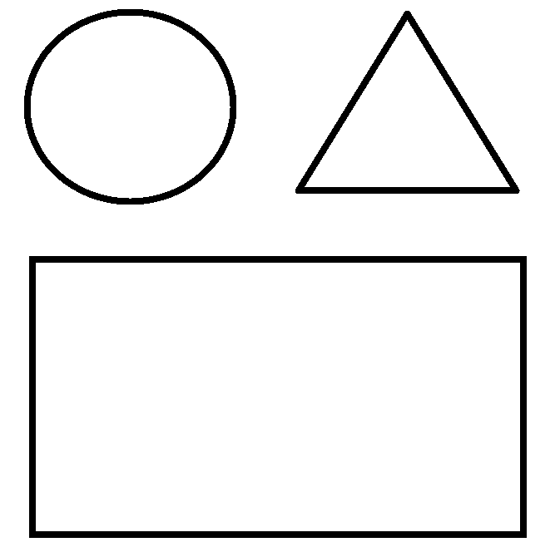
Changes?
How do we change our thought maps?
Over time we either change our thought maps to align with our beliefs or our original thought map become a default response to similar situations (events).
A way to show a Thought Map:
The O (circle) represents the thoughts in response to an event
The Δ (triangle) represents feelings
The □ (rectangle) represents the action or behavior

Slide 10
Show me?

Slide 11
That’s a Wrap?
Summary:
Over time, millions of thought maps are formed, in response to events we experience.
These include how we behave, feel and think.
While the original thought map (TM₀) never goes away, it is no longer the default response.
This model gives insight into what steps need to be taken to achieve positive, lasting change.
It should be noted, however, that change is not easy and it needs to be nurtured to help the individual not fall back into the old or recycled way of thinking.
Next Time!
Thought Mapz 2 – More Good Stuff

