Slide 1
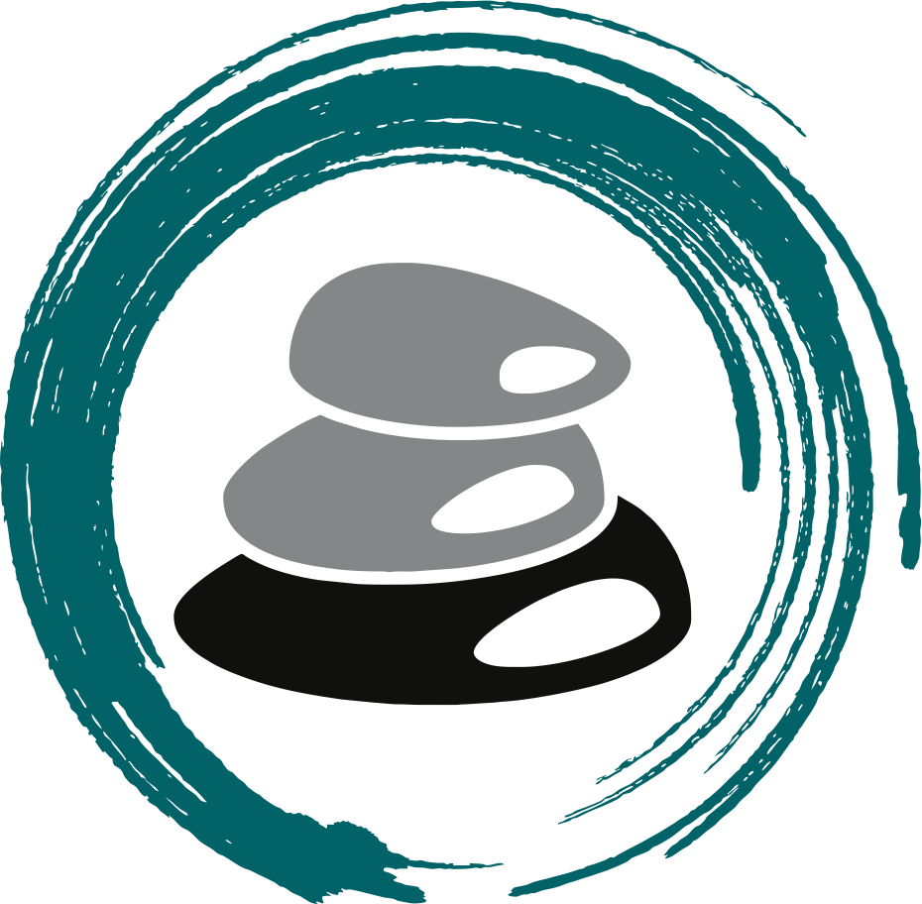
#Self-Esteem
Healthy Interactions Group (HIG)
Michael Noll Counseling, LLC

Slide 2
Where To Today…??
A Week Ago…
Styles of Communication
4 of them
What they mean
“I” Statements
Now
An Assessement
What’s Self-Esteem?
Concepts
Cost/Benefit Analysis
Foundations of Self-Esteem

Slide 3
Knowledge Check?
Rate Yourself from 0-10 (0=Nope 10=Absolutely)

Slide 4
Knowledge Check?

Slide 5
What’s That??
Self-esteem is a realistic, appreciative, opinion of oneself
Realistic means accurate and honest
Appreciative implies positive feelings and liking
Measured as high or low, which makes it seem like a numbers game - competitive or comparative. It works better when we say that those who possess self-esteem have a realistic and appreciative opinion of themselves.
The figure below clarifies the meaning of self-esteem. It is balanced between self-defeating shame and self-defeating pride.
Pride: Arrogant/Narcissistic
Shame: below others, unworthy, beneath them

Slide 6
How Do I Get There?
What Leads to Self-Esteem?
Research is pretty clear:
“Choose your parents well”
A Quick Story: A man asked his neighbor, "Why did you spend all day with your son fixing that bike, when the bike shop could have fixed it in an hour?" The neighbor replied, "Because I am building a son, not fixing a bike.“
Parents/Mentors help in building, especially as they show/build the kiddo up
"I trust you, but I also recognize that you are not perfect. Still, I love you, and therefore will take time to guide you, set limits, discipline you, and expect the best of you because I believe in you and value you."
But, what if there are no parents involved, how does one have self esteem?

Slide 7
What’s Involved?
Identity
Identity provides a sense of oneself and one’s individuality
It answers these questions: “Who am I?” and “What defines me and my essential character?”
Appreciate
To think well of, value, to enjoy
To recognize gratefully
To rightly estimate the quality or worth of someone or something
Accept
To receive favorably and with pleasure, to approve, to believe in, and to respond favorably to someone or something
Self-acceptance is to believe in oneself favorably and with pleasure
One may accurately acknowledge weaknesses, be determined to improve, and still accept oneself

Slide 8
There’s Gotta Be More…Yup!
Self-Confidence
The belief in one’s own abilities
Related to competency and self-efficacy
As one’s competence increases, one’s confidence does too
In a broader sense, self-confidence is a belief in oneself as a person
The general sense of, “I can do it!”
Pride
2 sides: self-defeating and healthy
“Self-defeating pride” is the attitude that one is superior, more valuable, or more important as a person than others.
Perceive themselves as more capable, self-sufficient, or infallible than they actually are
“Healthy pride” is a realistic sense of one’s own dignity or worth; self-respect; and gratitude and delight in one’s achievements, talents, services, or membership (that is, in family, race, and so forth).

Slide 9
More?…Yup!
Humility
2 sides: self-defeating humility and healthy humility.
“Self-defeating humility” is spineless submissiveness, contemptibly, and an abject lack of self-respect.
“Healthy humility”, on the other hand, involves the absence of self-defeating pride, and the recognition of one’s imperfections or weaknesses, a consciousness of one’s own shortcomings and ignorance, and teachableness. Healthy humility relates to meek behavior in the positive sense, meaning one is mild, patient, and not easily stirred to anger.
A person with self-esteem possess both healthy humility and healthy pride:
Humility because they realize how much they have left to learn, and pride in recognizing the dignity and worth one shares with all other humans.

Slide 10
Even More?…Yup!
Selfishness
Some mistakenly equate selfishness with self-esteem.
So let’s make an important differentiation:
The purpose of self-esteem is to transcend the self
Self-consciousness is a painful situation that keeps one’s focus inward
Healing the pain with love, enables one’s focus to expand outward, making one freer to love others and enjoy life
The person with self-esteem loves by choice from a secure base (as opposed, say, to a codependent individual who possesses neither self-esteem nor choice)
Thus, building self-esteem warrants our best efforts

Slide 11
What’s the Cost?
Cost-Benefit Analysis
Some people do not build self-esteem because they don’t know how -- others resist building self-esteem because there are apparent advantages to self-dislike. Before investing the time in building self-esteem, let’s do what an effective manager would do before considering a new plan: a cost-benefit analysis.
First, list all the advantages of self-dislike you can think of
When you are finished, list all of the disadvantages
Next, the disadvantages of Emotional Change
Finally, list the advantages of Emotional Change

Slide 12
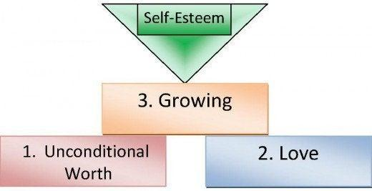
Let’s Build?!

Slide 13
Done Already?!
Recap
An Assessement
What’s Self-Esteem?
Concepts
Cost/Benefit Analysis
Foundations of Self-Esteem
Next Time
More Self Esteem
Unconditional Worth
Love
Growing

