Slide 1

#Self-Esteem
Week #3
Healthy Interactions Group (HIG)
Michael Noll Counseling, LLC

Slide 2
Where we’re going today…
Self Esteem
  Review of Concepts
    How to Build Self-Esteem
      Human Worth
      Unconditional Love
      Growing
Today
  Positive Side of Neutral
  Cognitive Distortions (a.k.a. Thinking Errors or Stinkin’ Thinkin’)

Slide 3



So…I know it all now, right?!
The Positive Side of Neutral
Fear of Judgement:
Recognize Irrationality
Treatment of Self
Give you a break
I’m human
Perception of the World
Positive Side of Neutral
View of the Past
Internal
External
Success/Failure
See Successes
  Accept
Feel Judged
Feel Rejected
Hard on Myself
Should be Perfect
Negative Perspective and Focus
Regret Choices
Angry about things done to me
Feel Like a Failure
Not Special

Slide 4
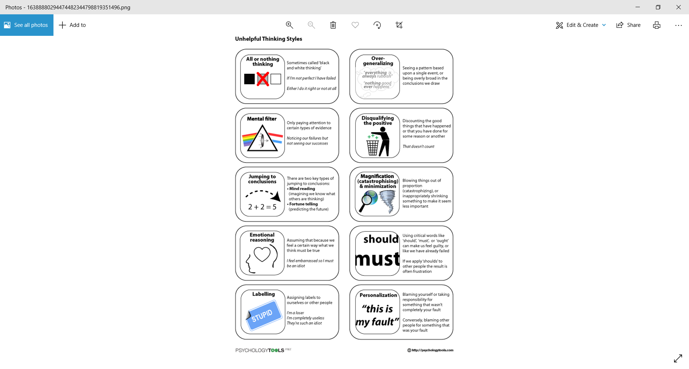
Anything else?
Dumb question, right?! Of course there’s more!
Cognitive Distortions, also called Thinking Errors or Stinkin’ Thinkin’
  Unhelpful Thinking Styles
  Ways our thoughts become biased
  Ways we try to “make sense” of the world around us
  Short Cuts
All or Nothing, Black and White, or Polarized Thinking:
John recently applied for a promotion in his firm. The job went to another employee with more experience. John wanted this job badly and now feels that he will never be promoted. He feels that he is a total failure in his career.

Slide 5
More? Yes, Please.
Overgeneralizing: Linda is lonely and often spends most of her time at home. Her friends sometimes ask her to come out for dinner and meet new people. Linda feels that that is it useless to try to meet people. No one really could like her. People are all mean and superficial anyway.
Mental Filter: Mary is having a bad day. As she drives home, a kind gentleman waves her to go ahead of him as she merges into traffic. Later in her trip, another driver cuts her off. She grumbles to herself that there are nothing but rude and insensitive people in her city.
Disqualifying the Positive: Rhonda just had her portrait made. Her friend tells her how beautiful she looks. Rhonda brushes aside the compliment by saying that the photographer must have touched up the picture. She never looks that good in real life, she thinks.

Slide 6
Even More? F’Real?
Jumping to Conclusions: Chuck is waiting for his date at a restaurant. She's now 20 minutes late. Chuck laments to himself that he must have done something wrong and now she has stood him up. Meanwhile, across town, his date is stuck in traffic.
Magnification and Minimization: Scott is playing football. He bungles a play that he's been practicing for weeks. He later scores the winning touchdown. His teammates compliment him. He tells them he should have played better; the touchdown was just dumb luck.
Emotional Reasoning: Laura looks around her untidy house and feels overwhelmed by the prospect of cleaning. She feels that it's hopeless to even try to clean.

Slide 7
Seriously?
Should Statements: David is sitting in his doctor's waiting room. His doctor is running late. David sits stewing, thinking, "With how much I'm paying him, he should be on time. He ought to have more consideration." He ends up feeling bitter and resentful.
Labeling and Mislabeling: Donna just cheated on her diet. I'm a fat, lazy pig, she thinks.
Personalization: Jean's son is doing poorly in school. She feels that she must be a bad mother. She feels that it's all her fault that he isn't studying.

Slide 8
Questions???
What doesn’t make Sense yet?
Do you feel as though you have an understanding of the steps to increasing “Self Esteem”? Why or Why Not?
What would your first step in increasing your self esteem need to be?

Slide 9
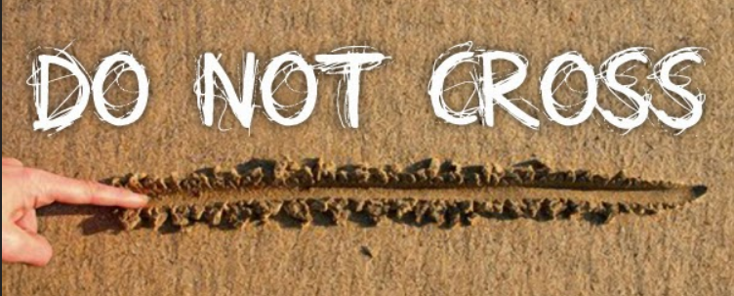
Next Week?
Next time:
  Boundaries!!

